Slide 1
Perky Learning
Drag and Drop
Activity
Shapes Themed

Slide 2


Slide 3
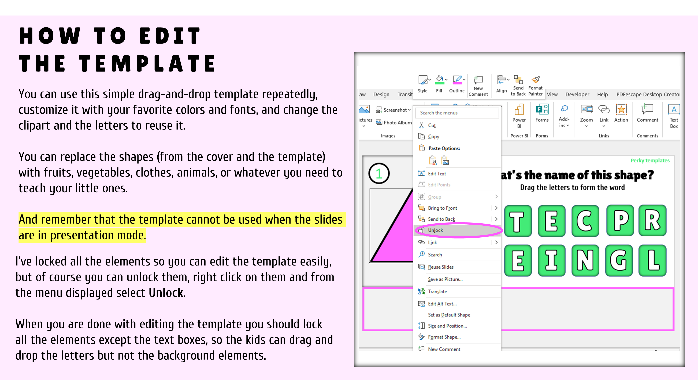

Slide 4
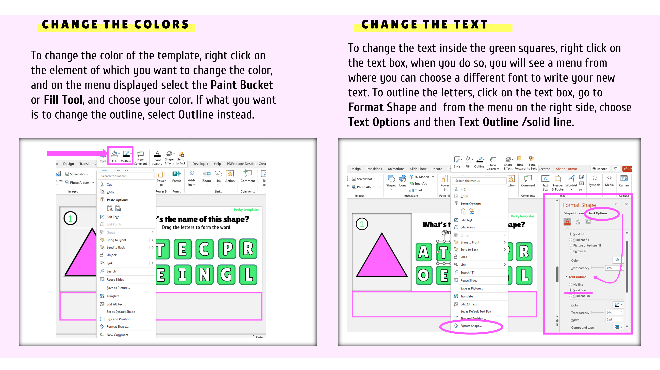

Slide 5
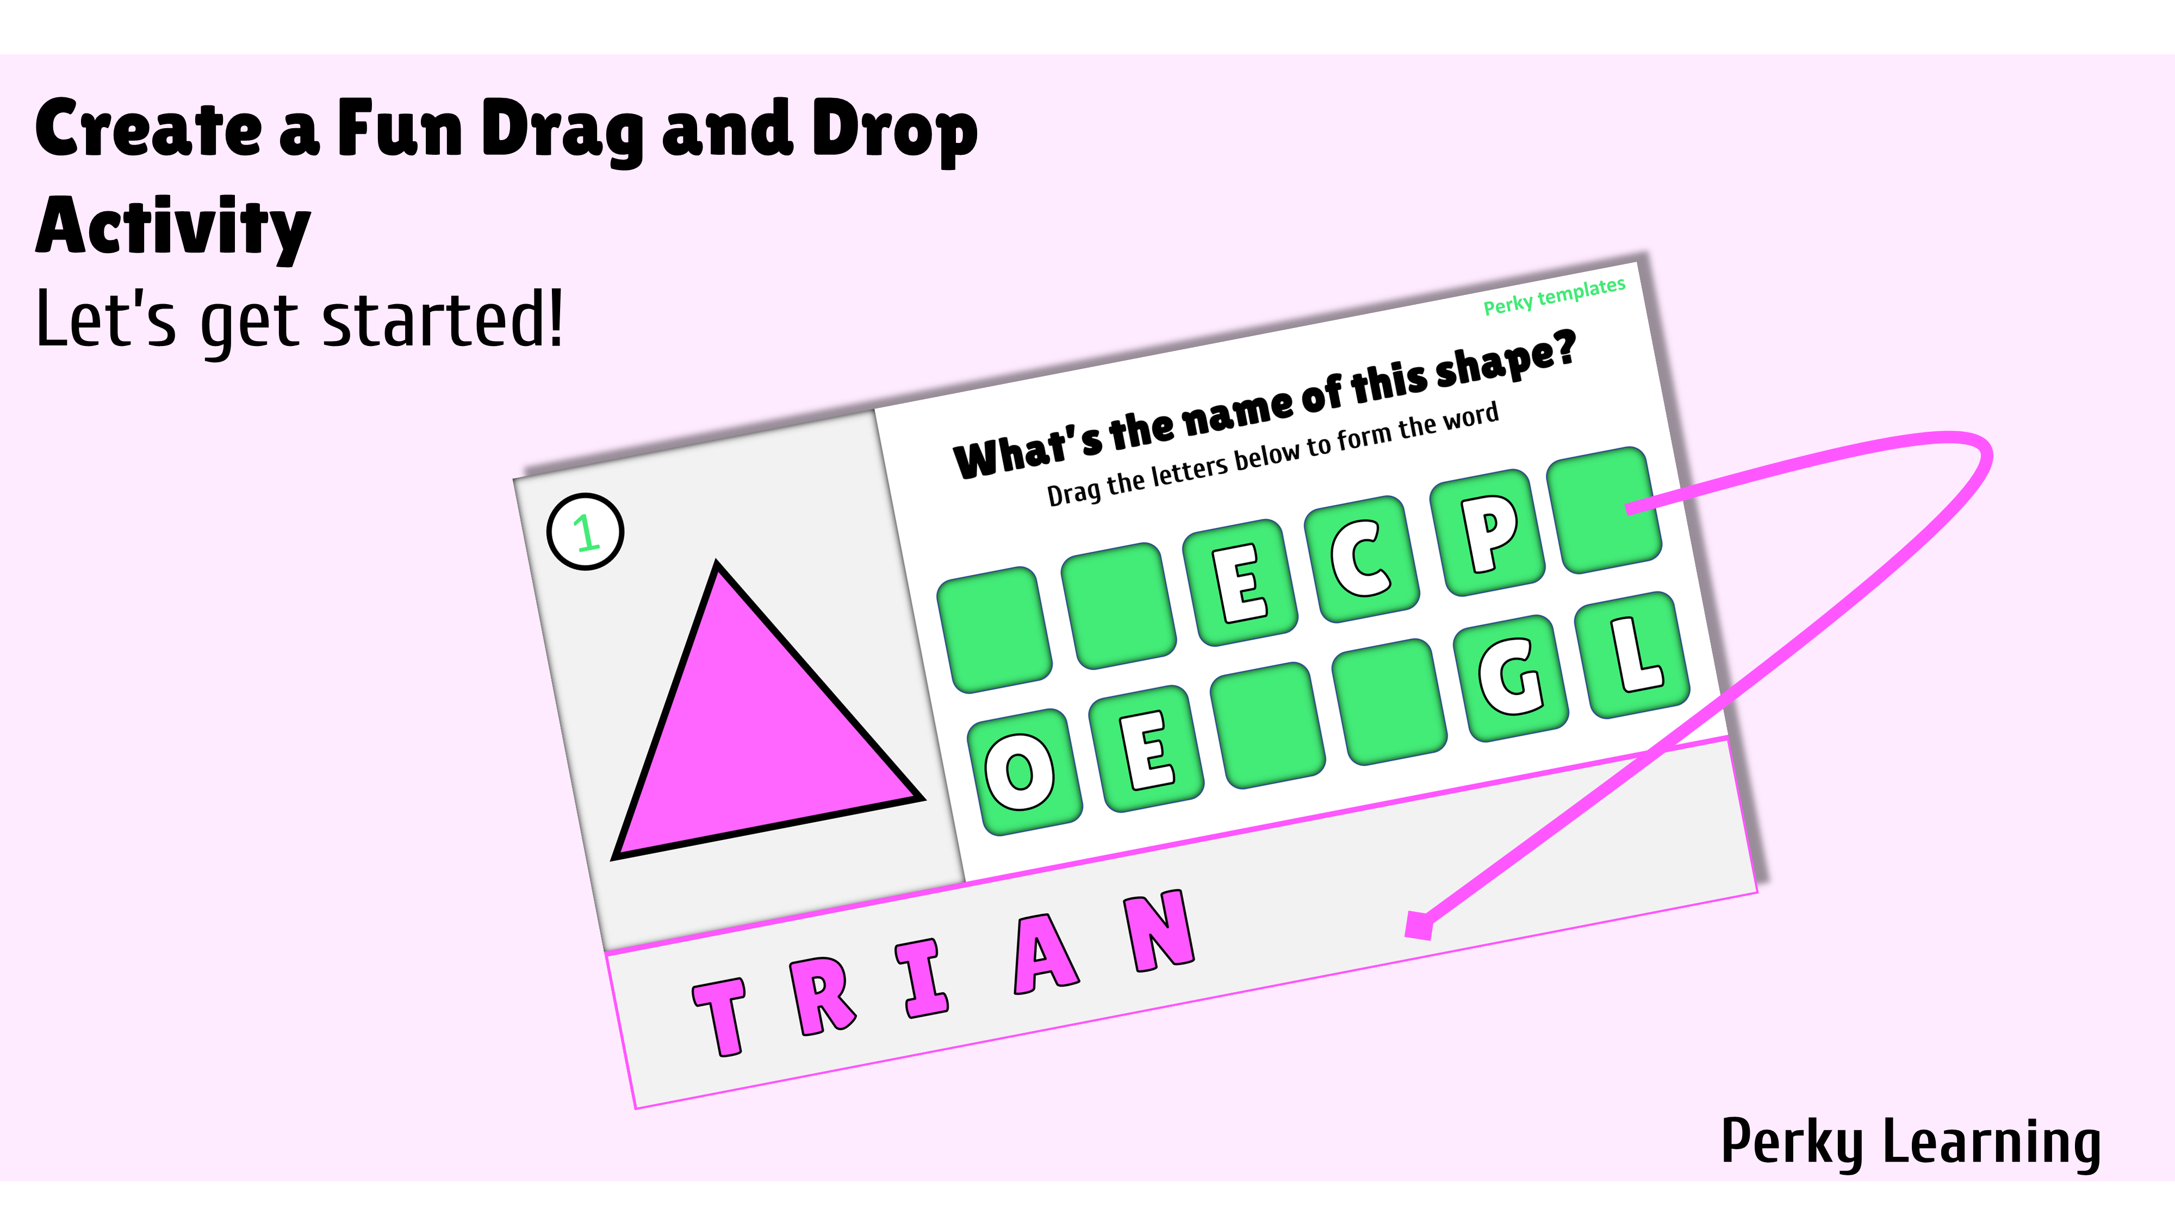

Slide 6
Perky Learning
1
What’s the name of this shape?
Drag the letters to form the word
A
T
E
C
P
R
O
E
I
N
G
L

