Slide 1
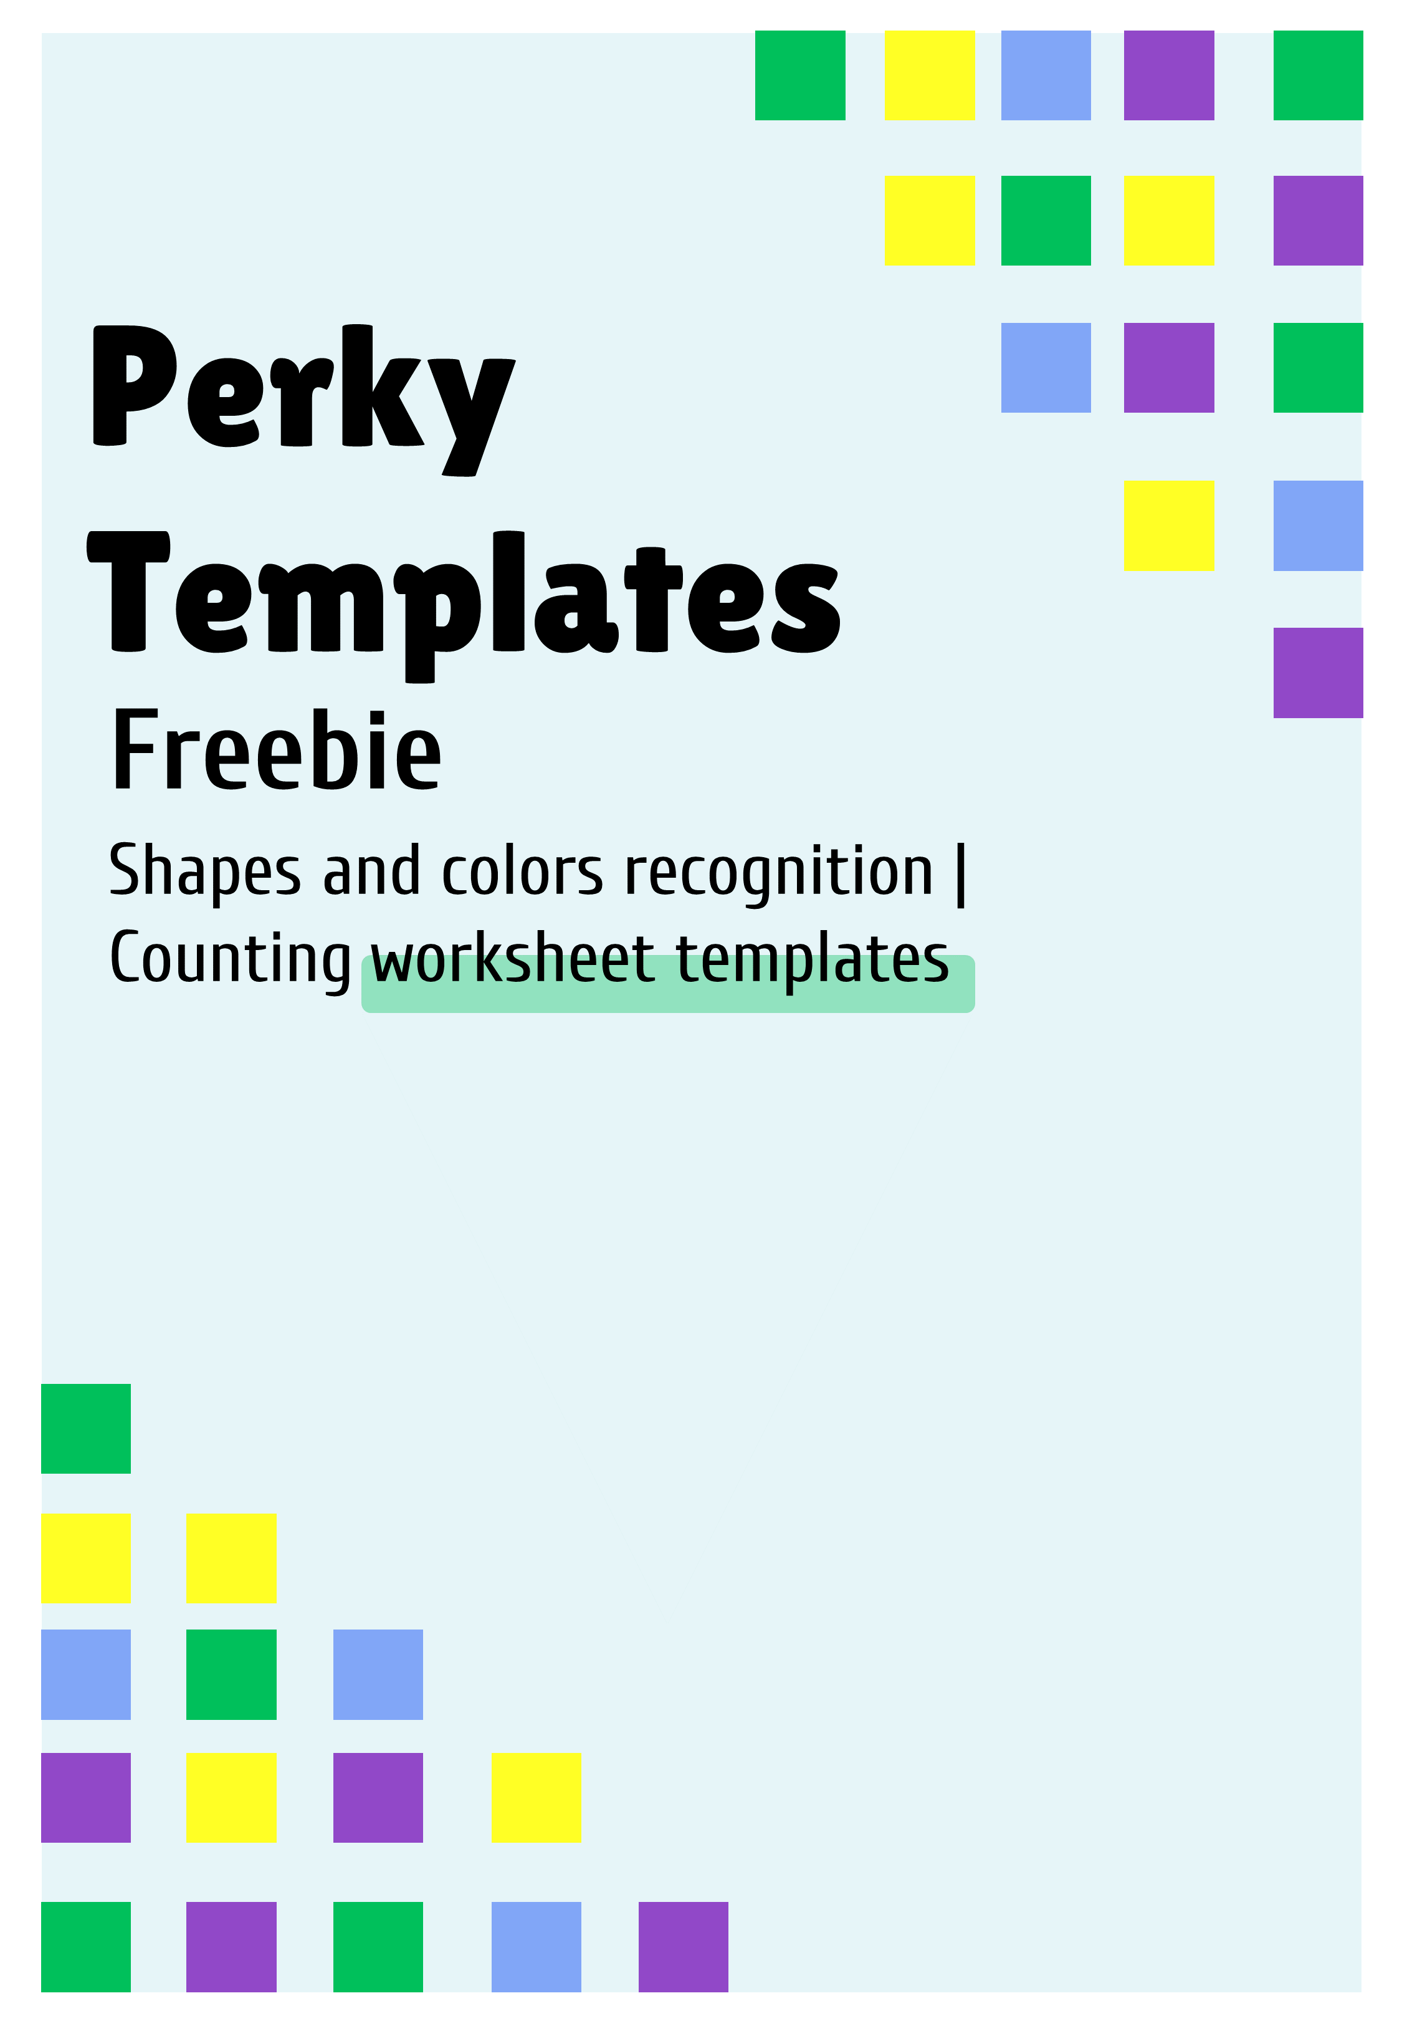

Slide 2
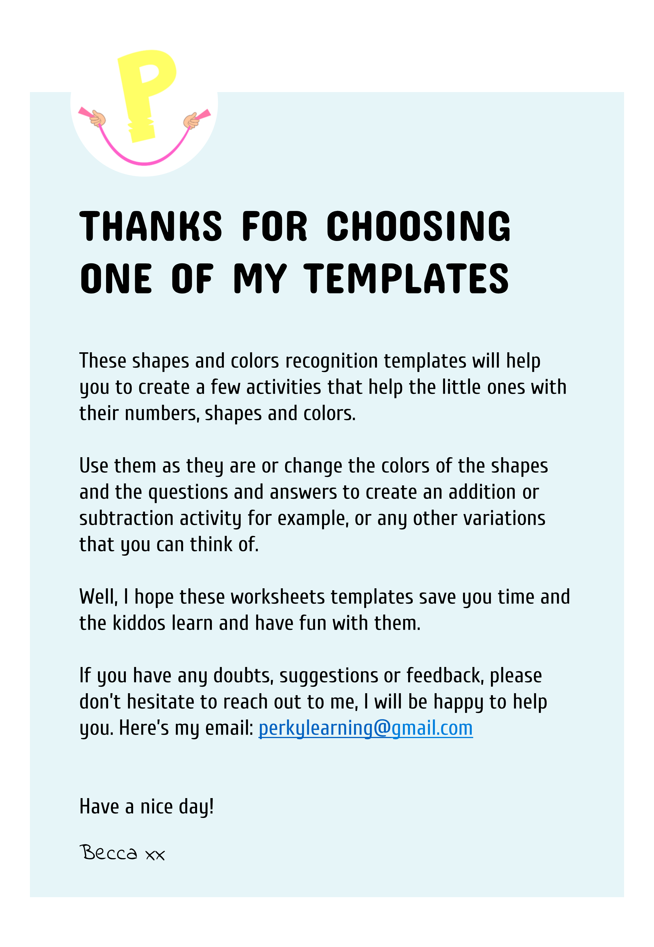

Slide 3
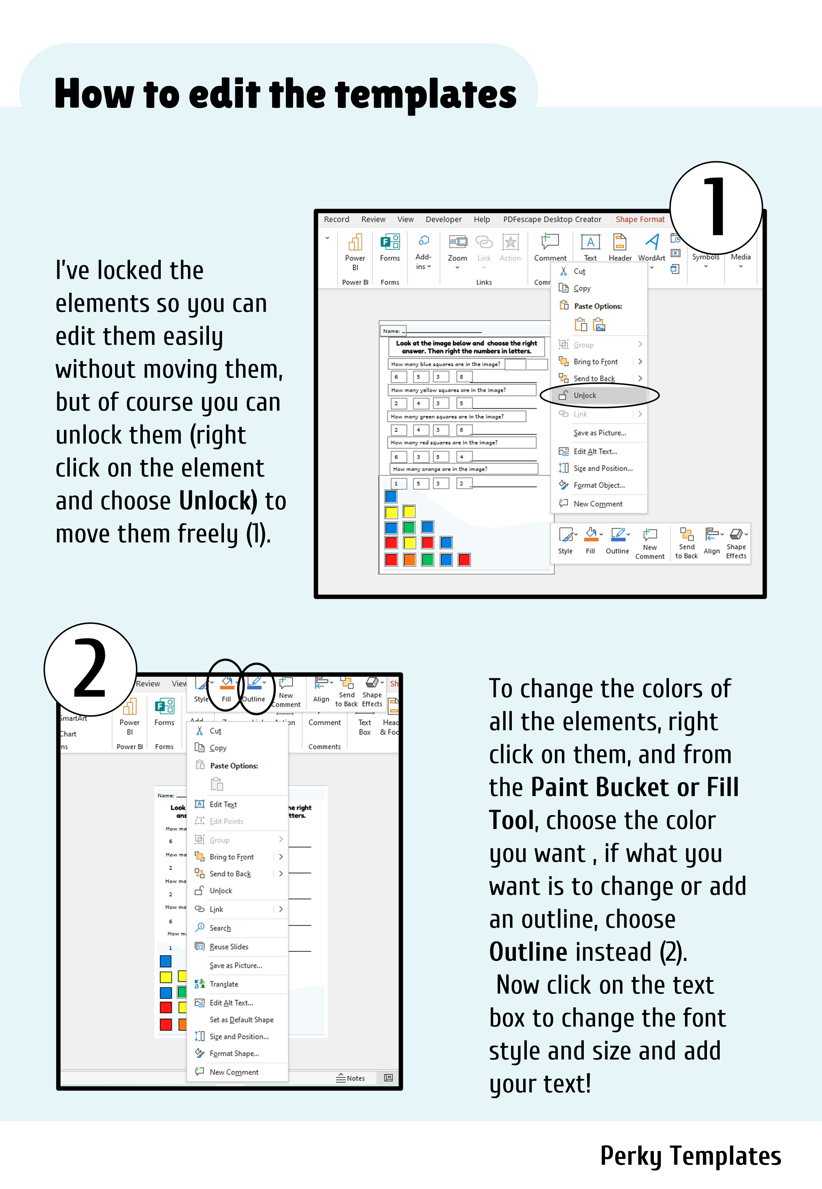

Slide 4
Name:
Look at the image below and choose the right answer. Then write the numbers in words.
How many blue squares are in the image?
6
5
3
8
How many yellow squares are in the image?
2
4
3
5
How many green squares are in the image?
2
4
3
8
How many red squares are in the image?
6
3
5
4
How many orange squares are in the image?
1
5
3
2
Draw and color a square below.
Perky Templates

Slide 5
Name:
Look at the image below and choose the right answer. Then write the numbers in words.
How many blue circles are in the image?
3
4
7
2
How many purple circles are in the image?
2
1
3
4
How many green circles are in the image?
3
5
2
6
How many pink circles are in the image?
0
2
3
7
How many yellow circles are in the image?
6
7
5
8
Draw and color a circle below.
Perky Templates

Slide 6
Name:
Look at the image below and choose the right answer. Then write the numbers in words.
How many blue triangles are in the image?
5
2
3
6
How many yellow triangles are in the image?
3
4
5
2
How many green triangles are in the image?
4
5
3
7
How many red triangles are in the image?
5
4
3
6
How many orange triangles are in the image?
2
3
1
5
Draw and color a triangle below.
Perky Templates

Slide 7
Name:
Look at the image below and choose the right answer. Then write the numbers in words.
How many blue rectangles are in the image?
6
5
3
8
How many yellow rectangles are in the image?
2
4
3
5
How many green rectangles are in the image?
6
4
3
8
How many pink rectangles are in the image?
6
4
1
8
How many white rectangles are in the image?
6
4
0
8
Draw and color a rectangle below.
Perky Templates

Slide 8
Name:
Look at the image below and choose the right answer. Then write the number in words.
How many blue triangles are in the image?
4
5
2
8
How many yellow squares are in the image?
3
4
2
5
How many green squares are in the image?
5
1
3
2
How many purple circles are in the image?
1
0
2
4
How many orange squares are in the image?
2
0
3
1
Draw and color your favorite shape below.
Perky Templates

Slide 9
Name:
Look at the image below and choose the right answer. Then write the number in words.
How many purple rectangles are in the image?
3
4
2
5
How many yellow trapeziums are in the image?
1
2
0
3
How many blue diamonds are in the image?
3
4
1
0
How many pink hearts are in the image?
0
2
1
3
How many black squares are in the image?
3
4
0
1
Draw and color a heart below.
Perky Templates

Slide 10
