Slide 1
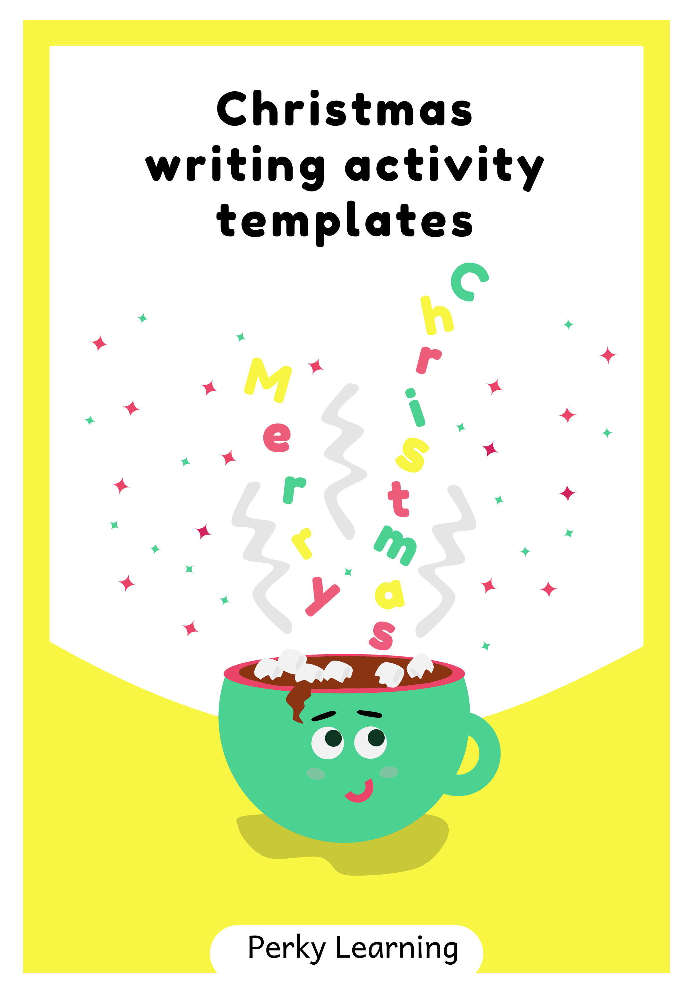

Slide 2
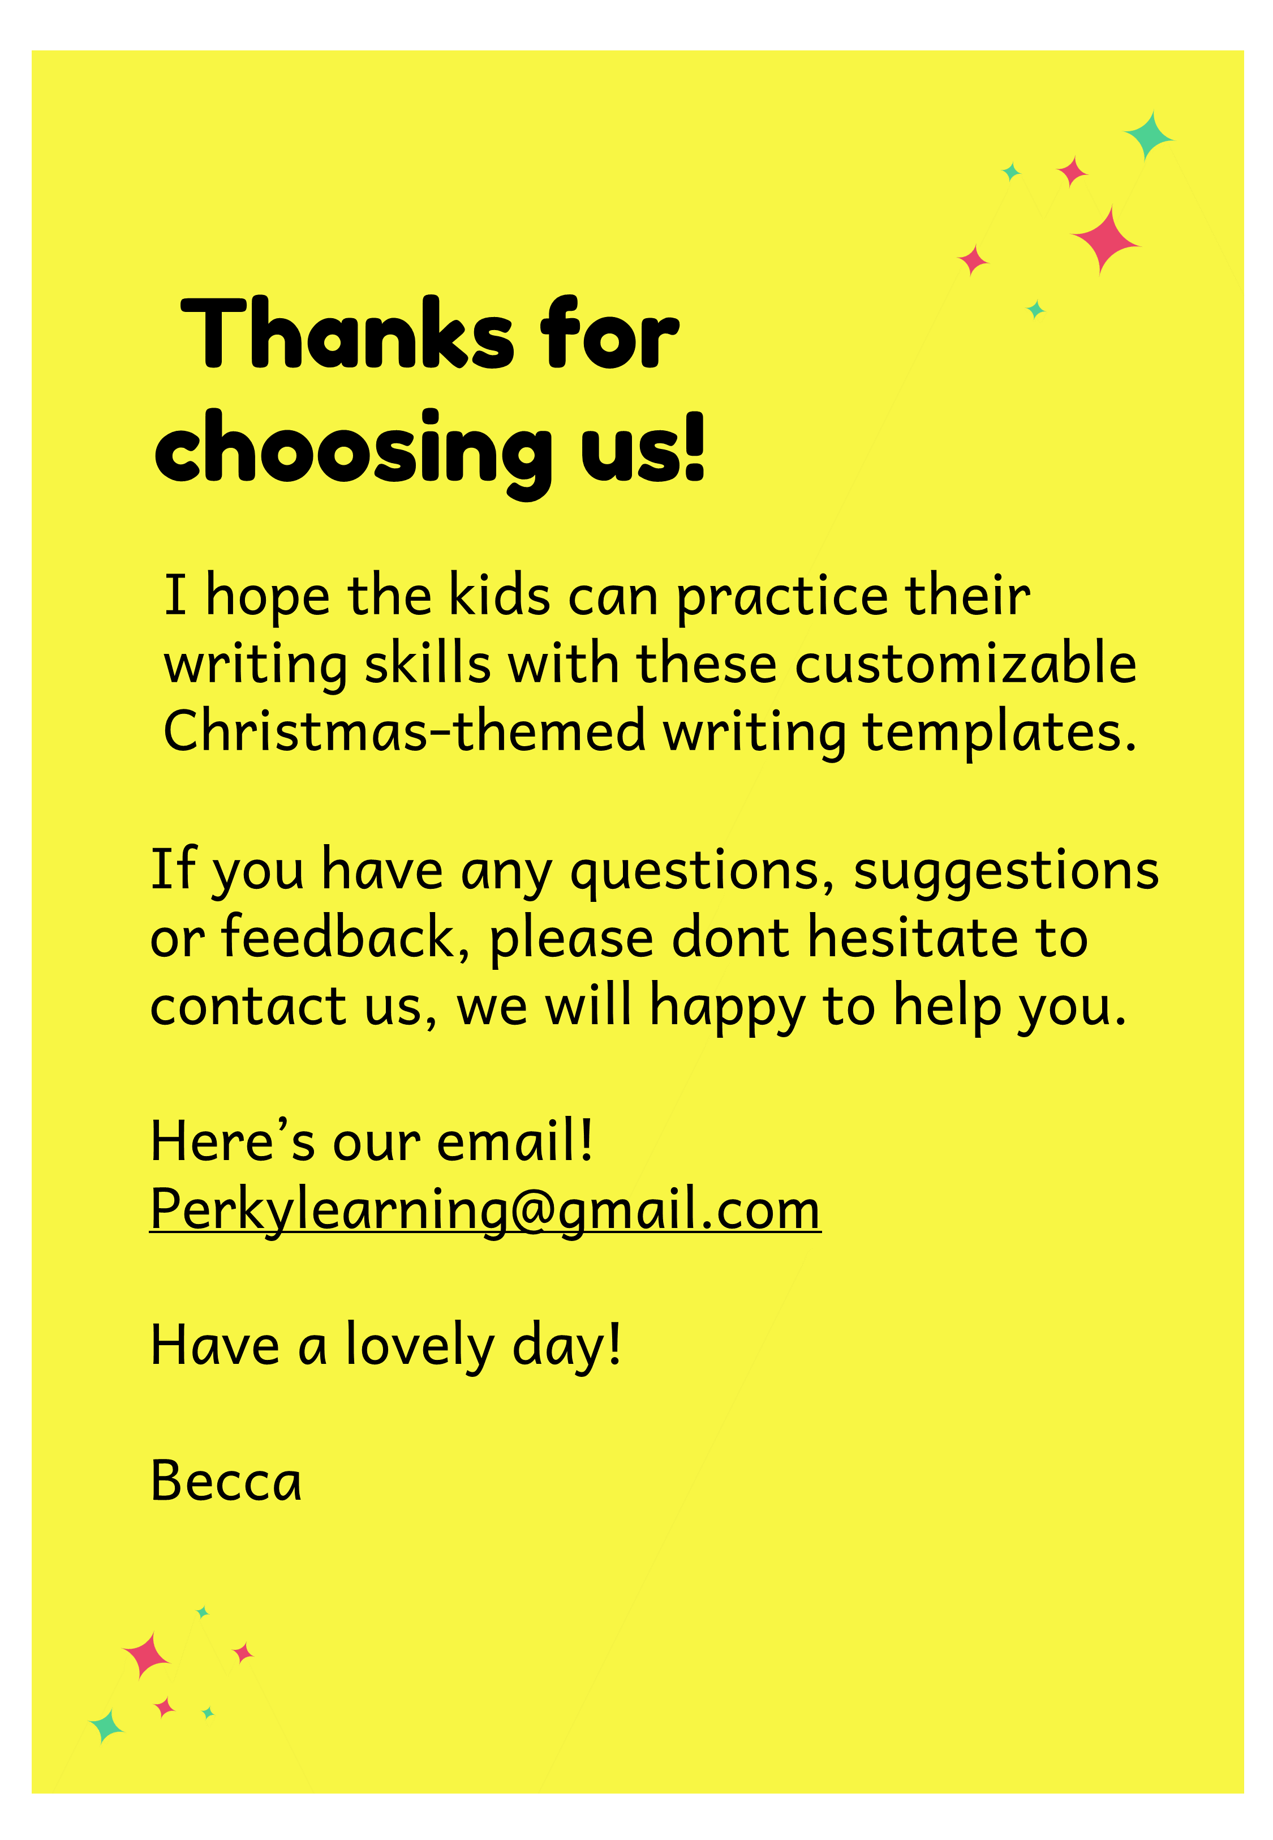

Slide 3
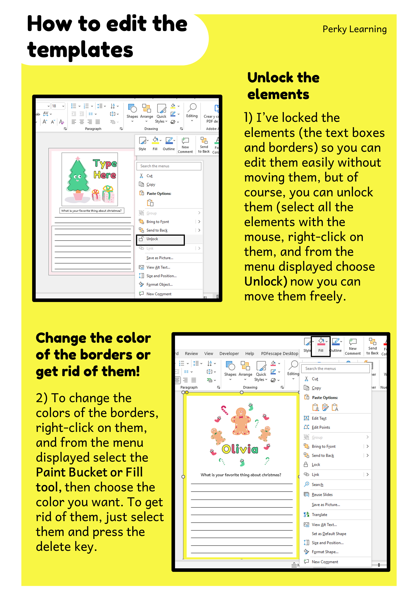

Slide 4
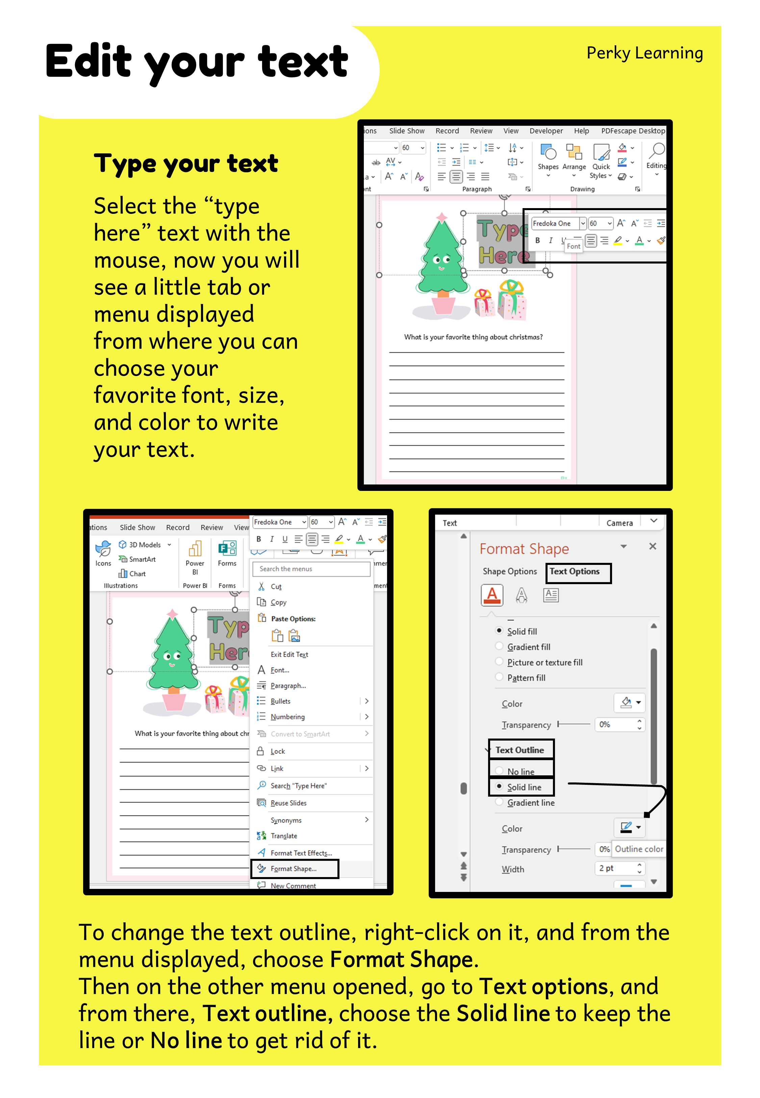

Slide 5
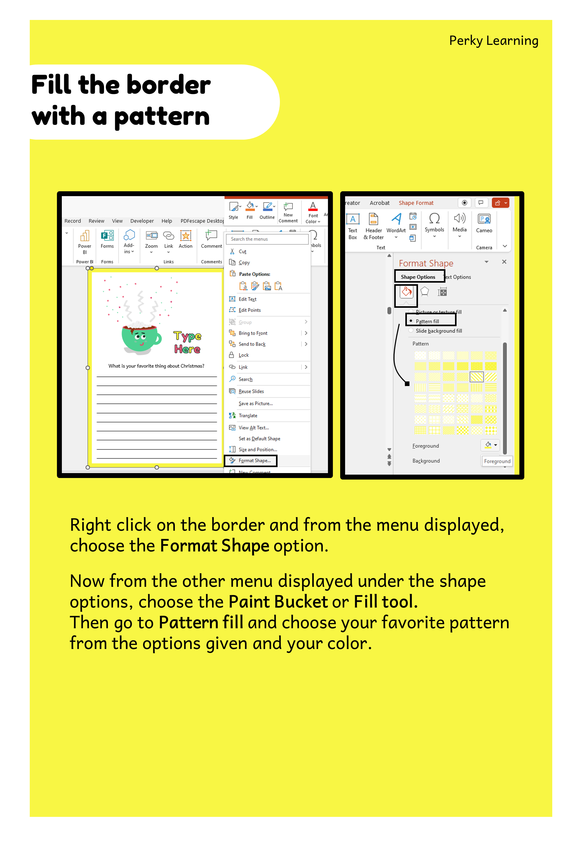

Slide 6
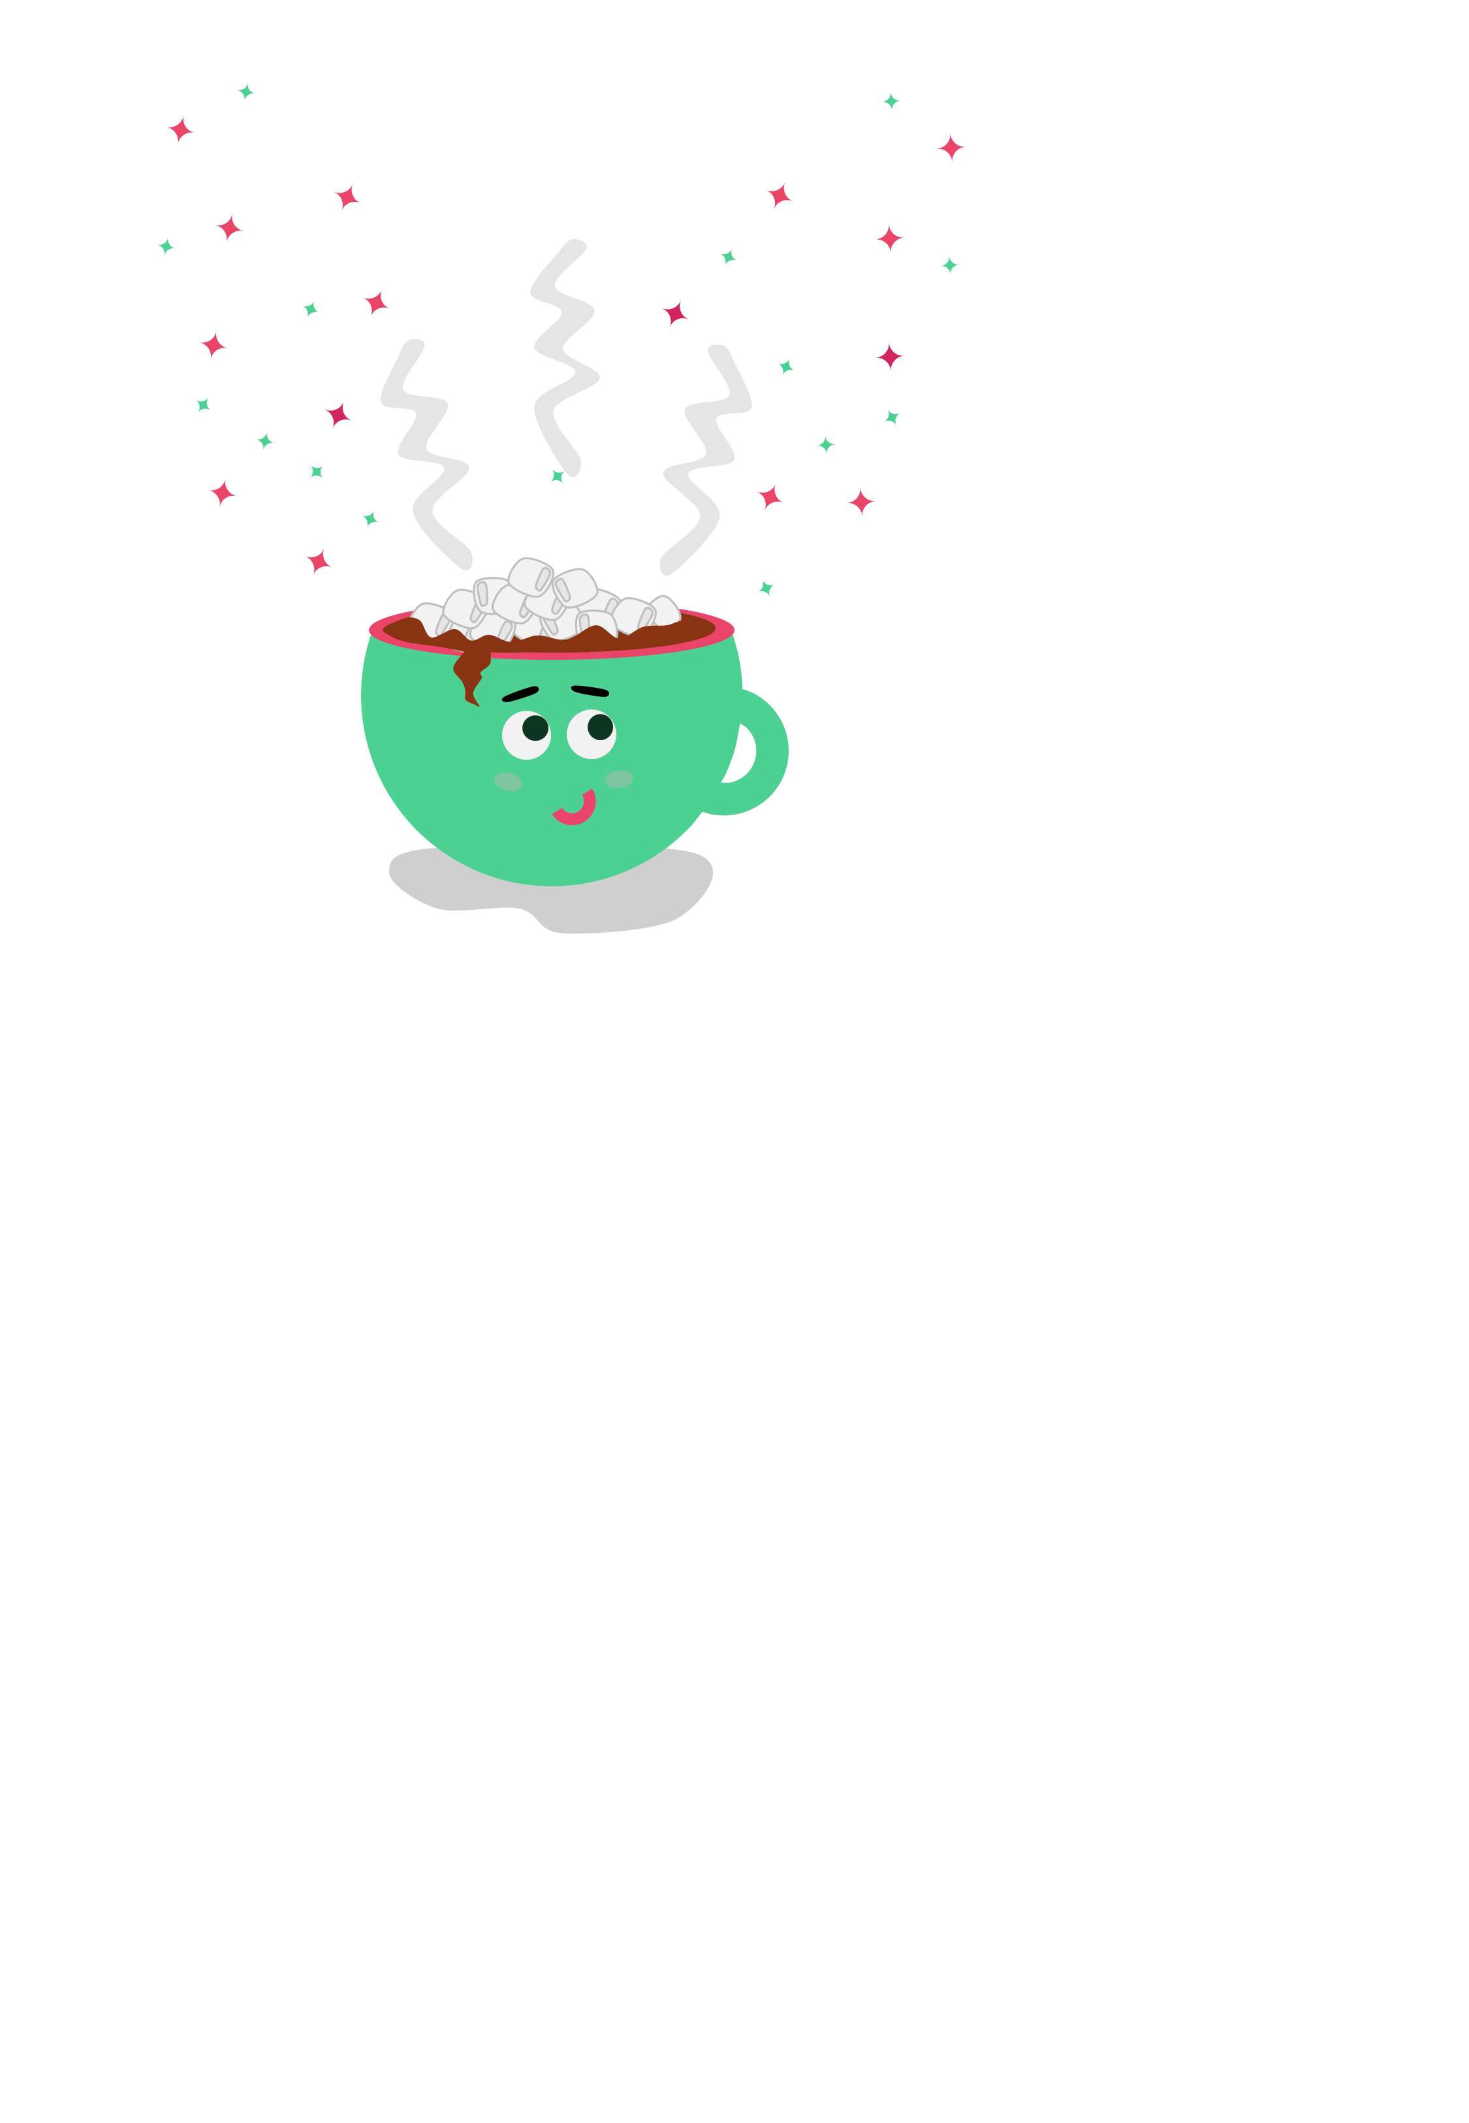
Type Here
What is your favorite thing about Christmas?

Slide 7
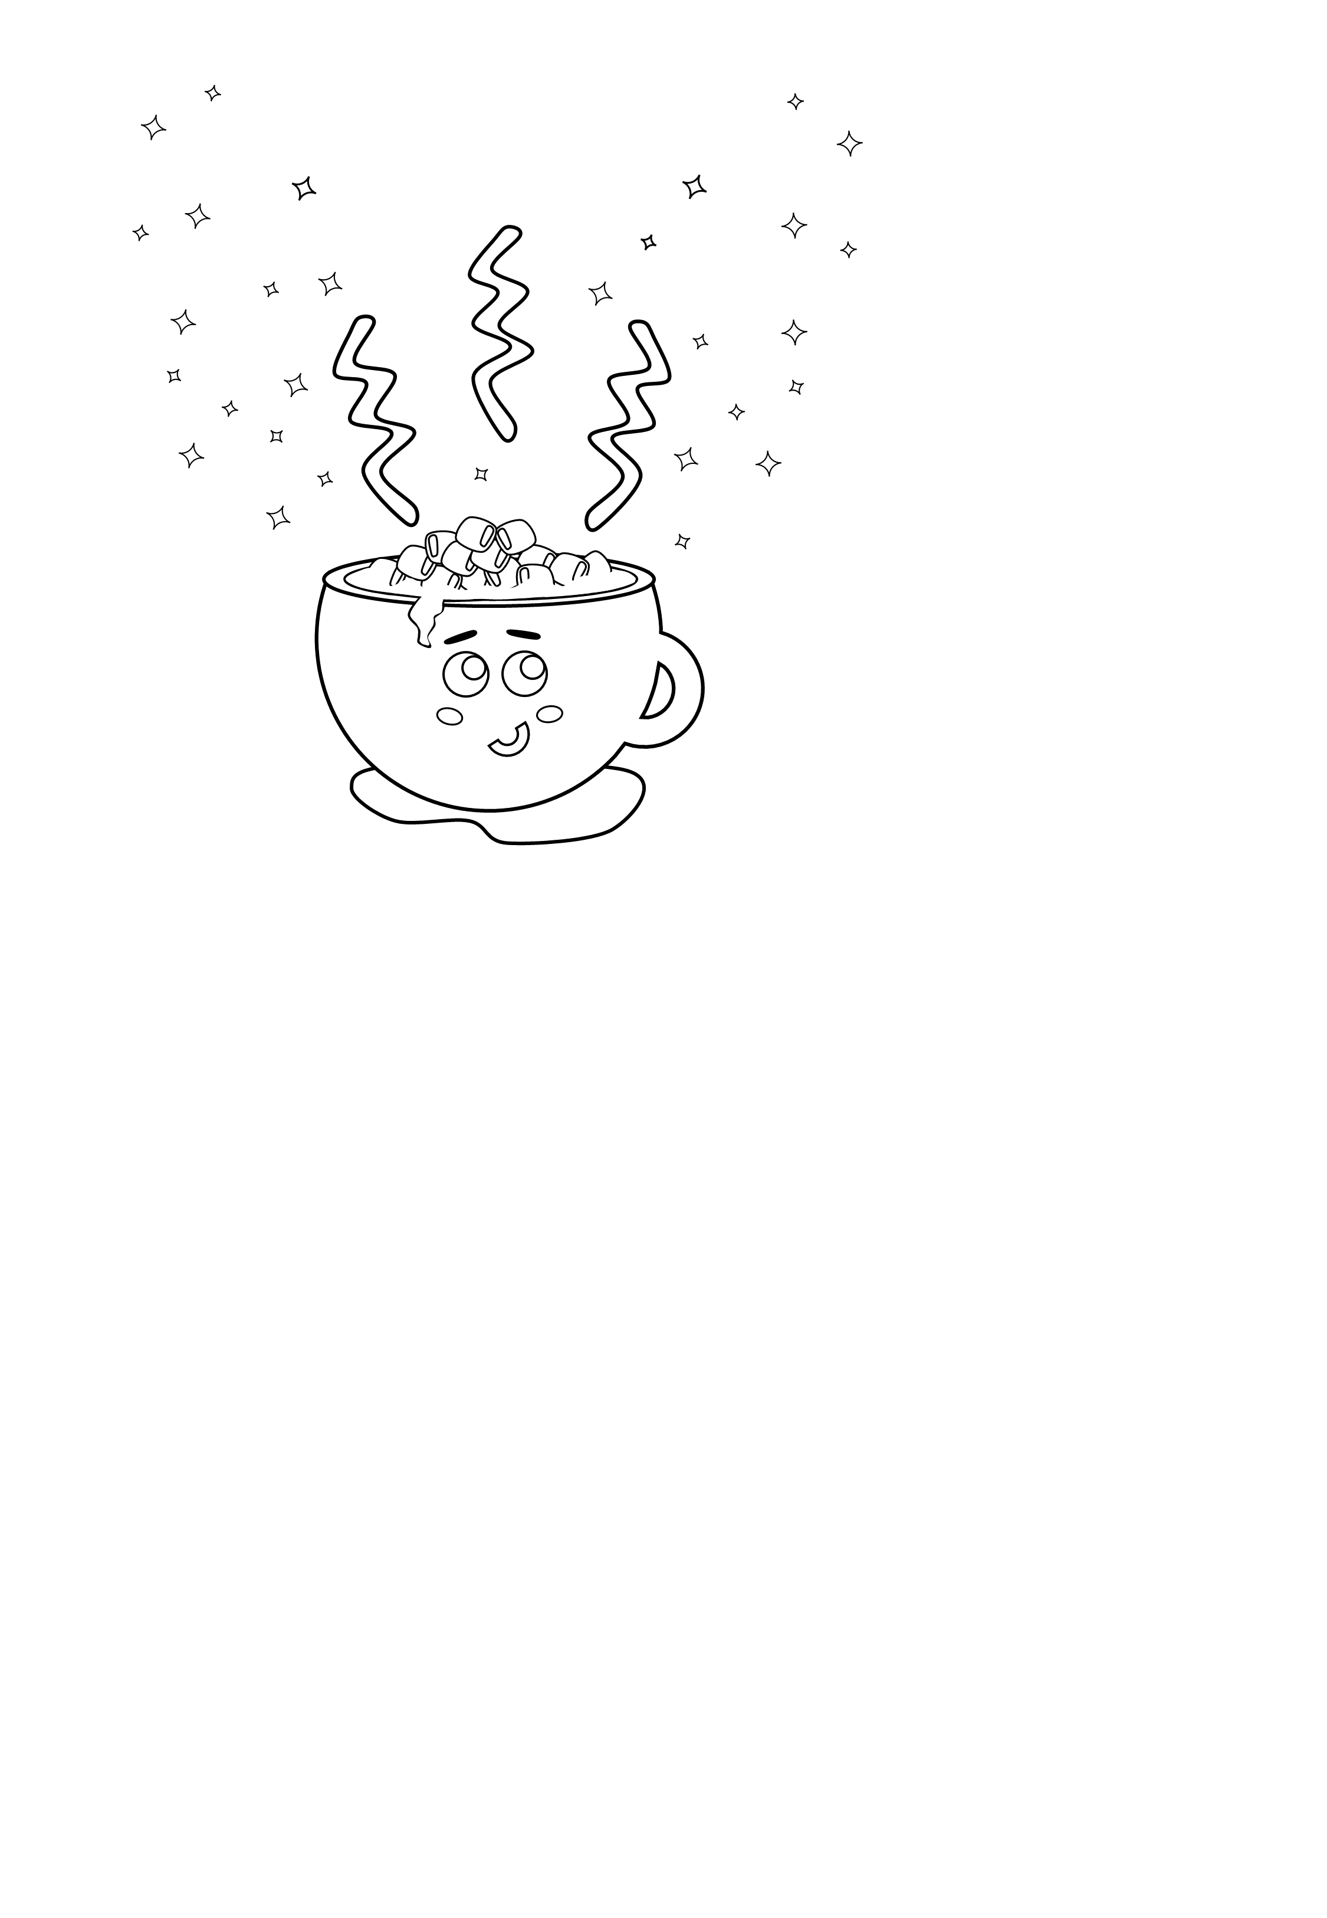
Type Here
What is your favorite thing about Christmas?

Slide 8
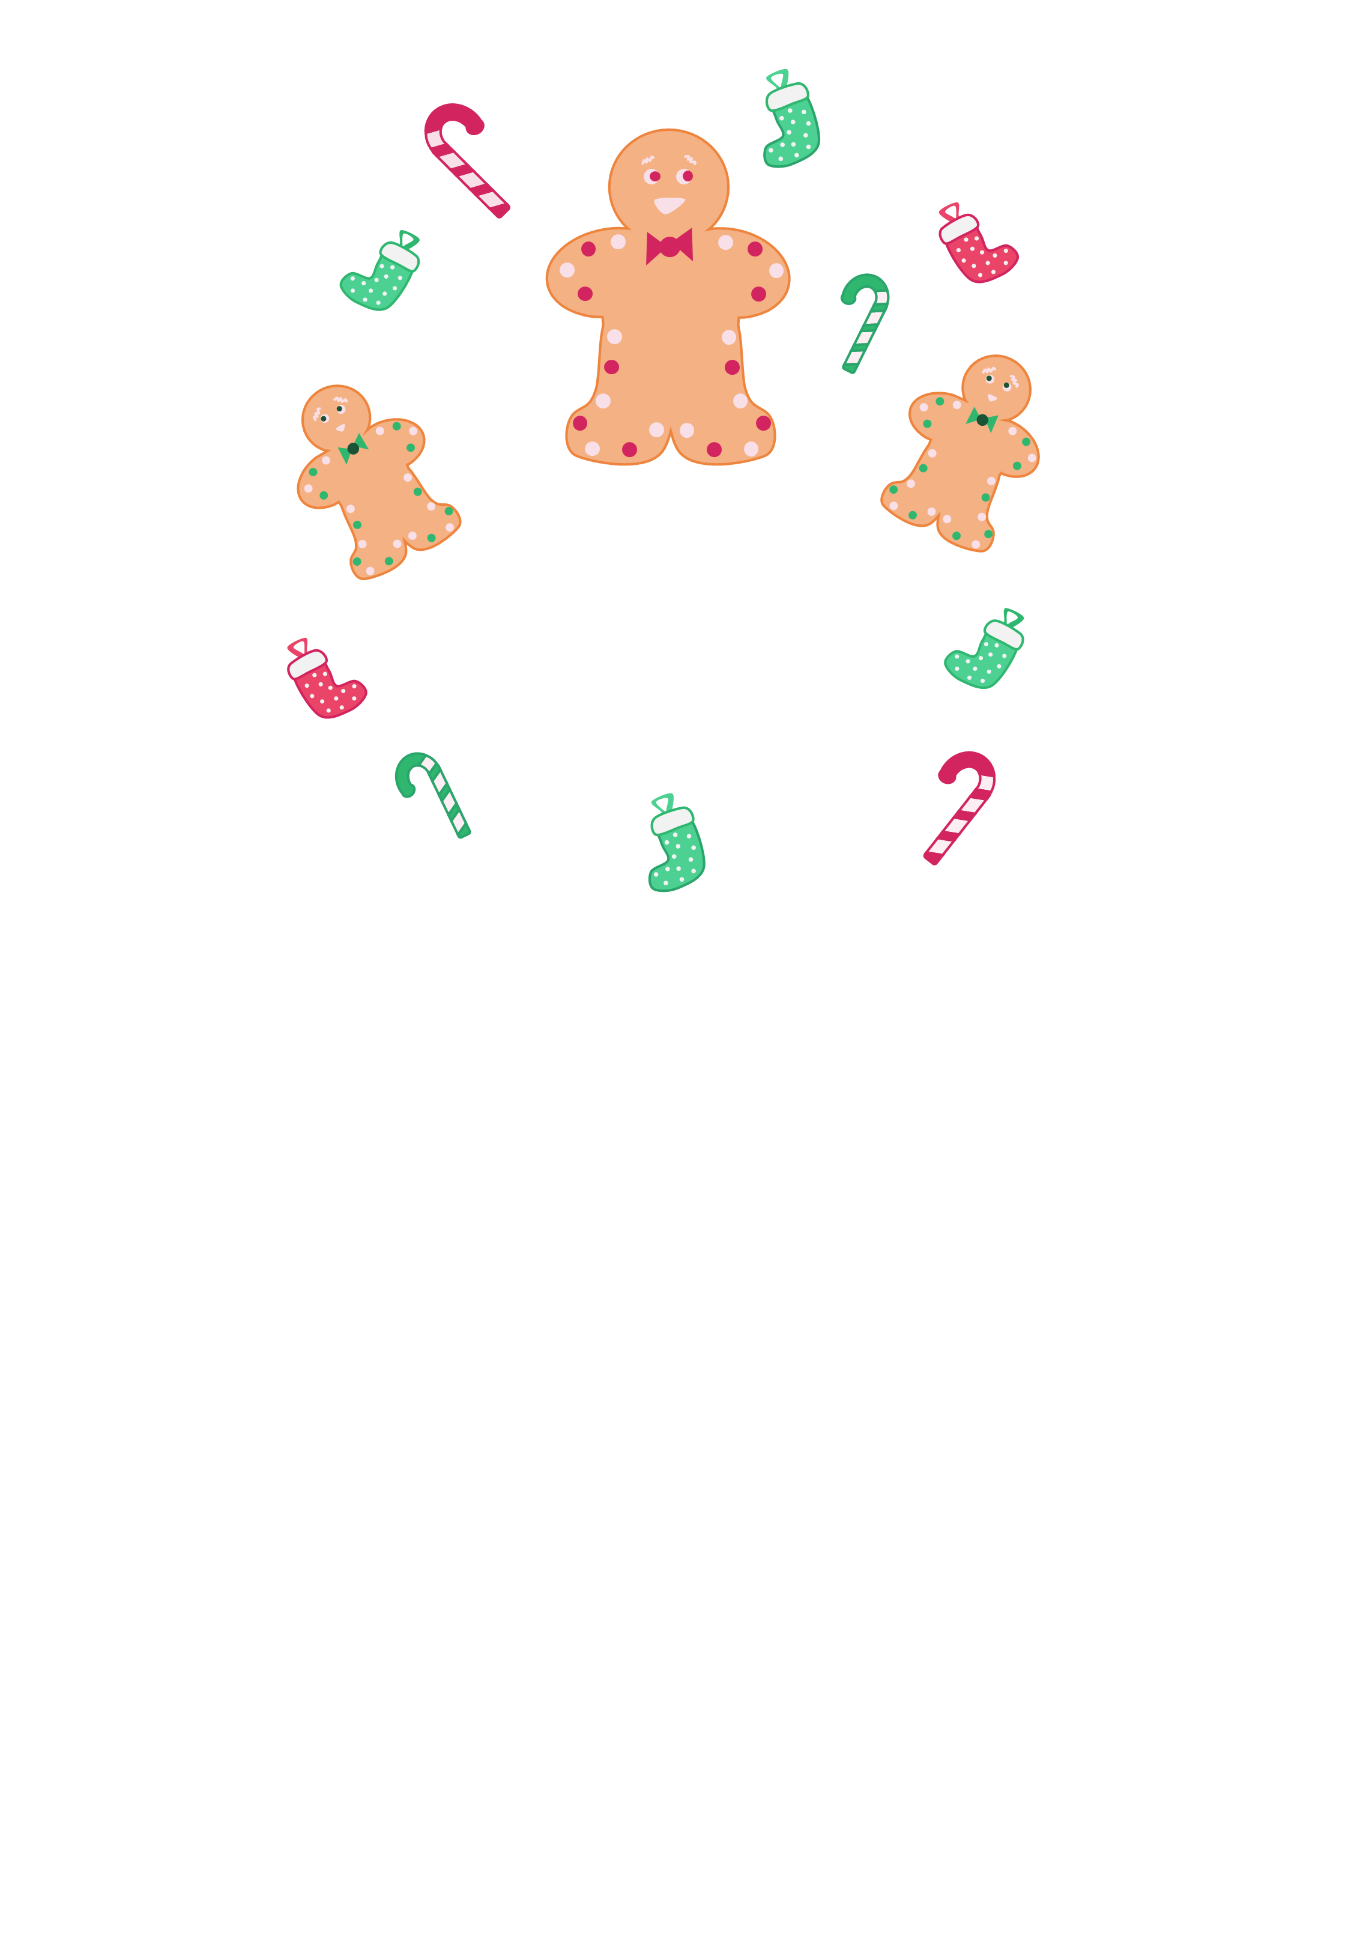
Type Here
What is your favorite thing about Christmas?

Slide 9
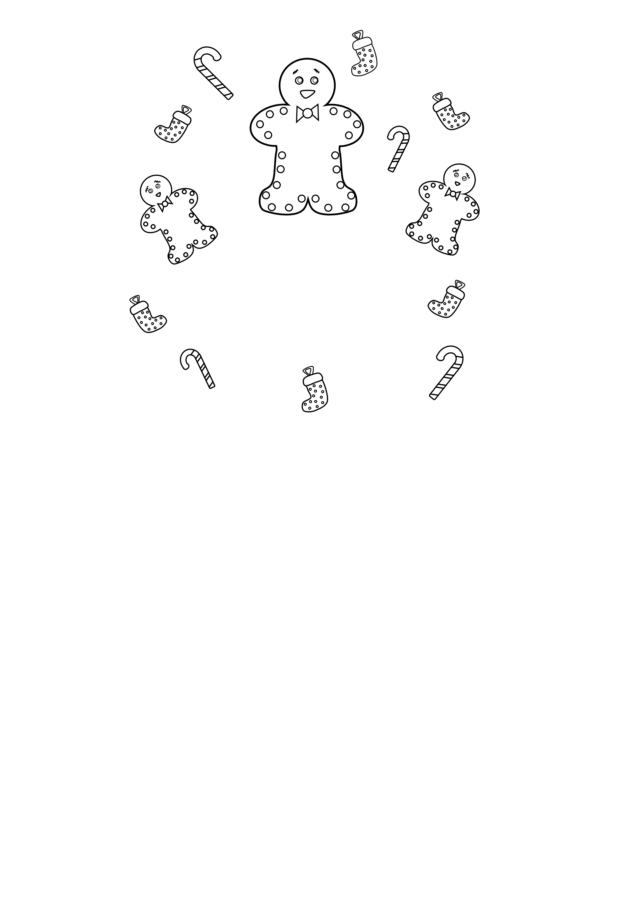
Type Here
What is your favorite thing about Christmas?

Slide 10

Ho
Ho
Ho
Ho
Type Here
What is your favorite thing about Christmas?

Slide 11
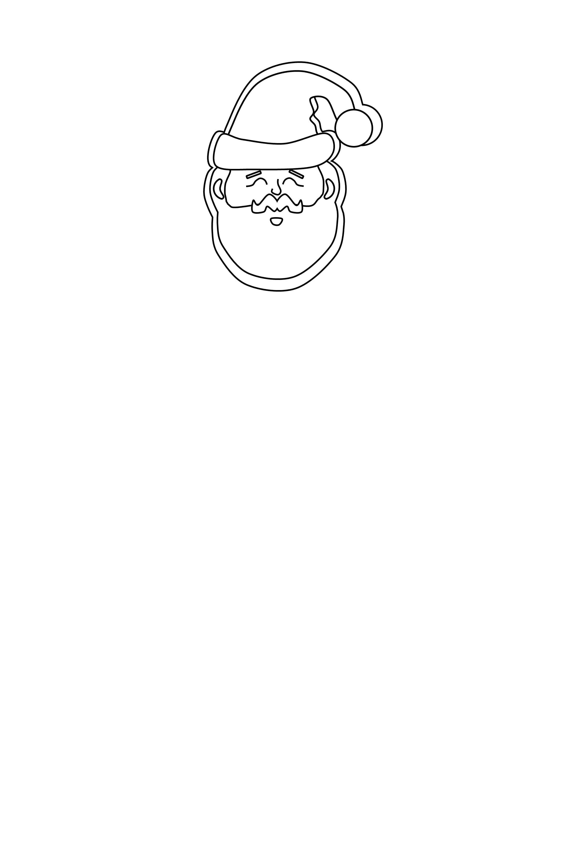
Ho
Ho
Ho
Ho
Type Here
What is your favorite thing about Christmas?

Slide 12
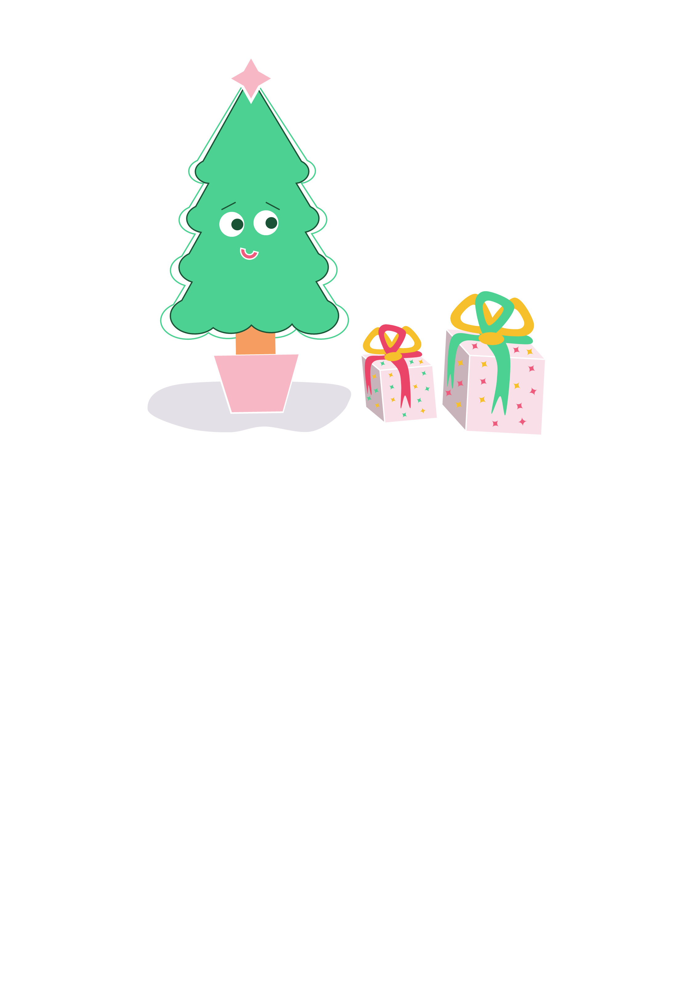
Type Here
What is your favorite thing about Christmas?

Slide 13
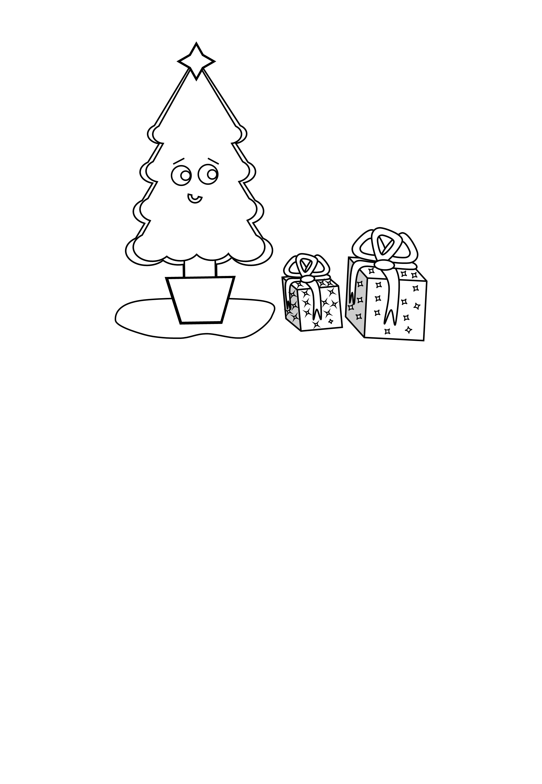
Type Here
What is your favorite thing about Christmas?

