Slide 5
Cut along the dotted lines
2”x3.5”
Your Text Goes Here
Your Text Goes Here
Type Here:
Type Here:
Type Here:
Type Here:
Your Text Goes Here
Your Text Goes Here
Type Here:
Type Here:
Type Here:
Type Here:
Perky Learning

Slide 6
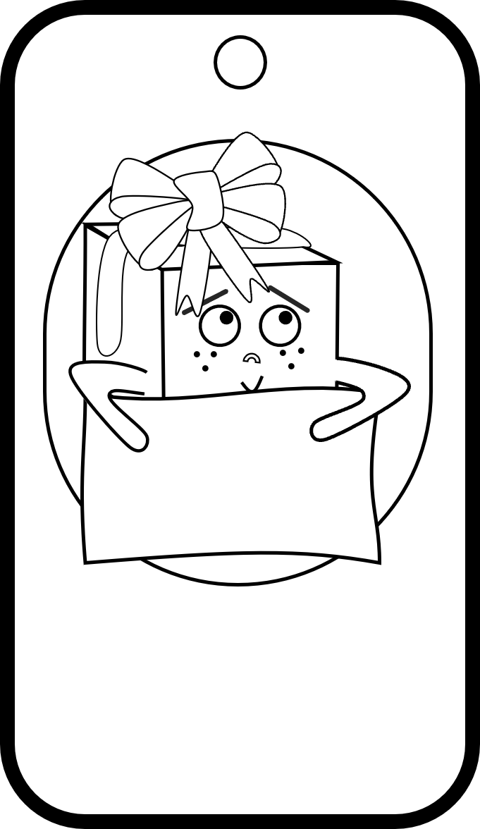
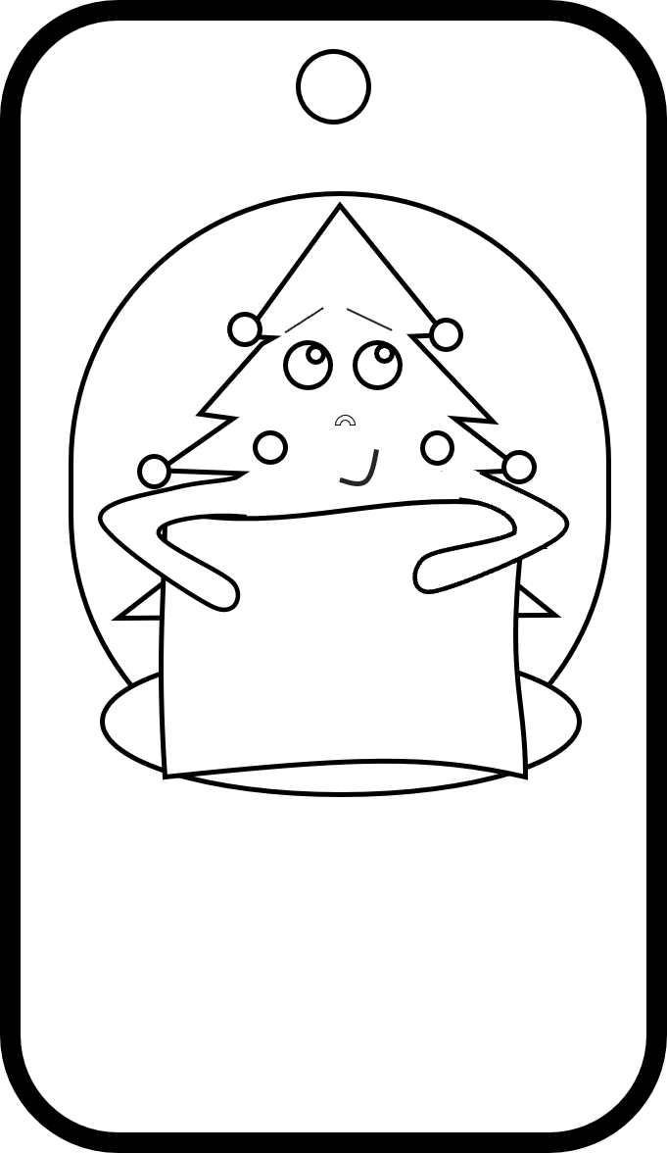
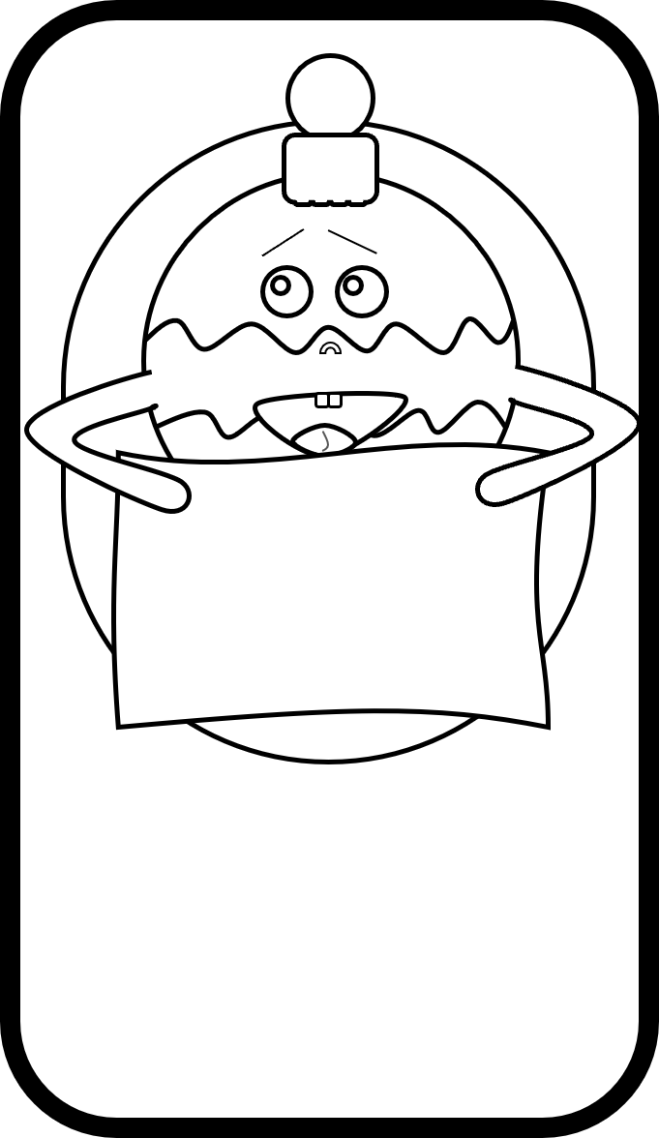
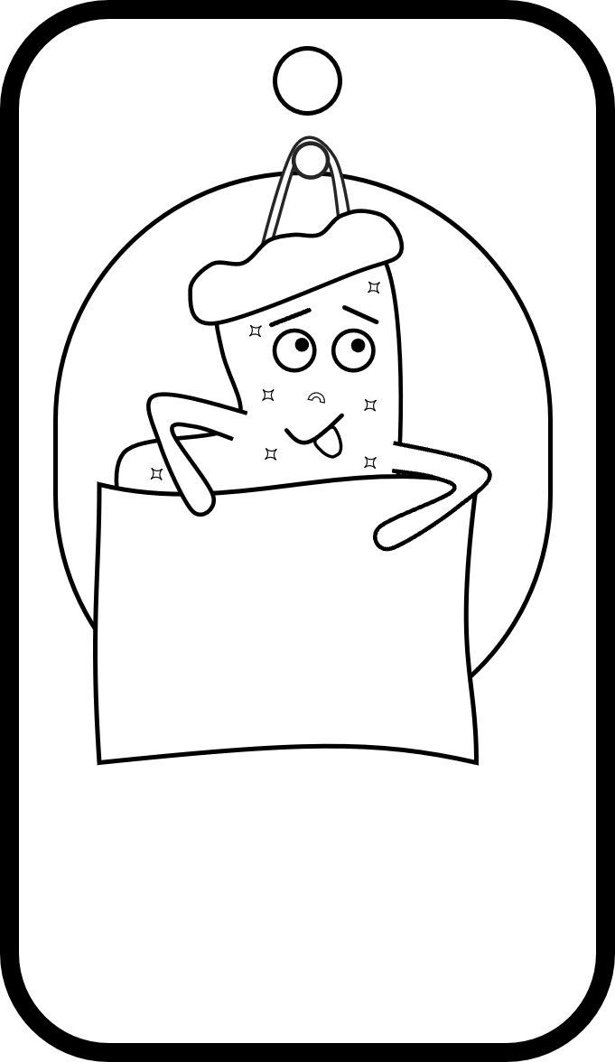
Cut along the dotted lines
2”x3.5”
Your Text Goes Here
Your Text Goes Here
Type Here:
Type Here:
Type Here:
Type Here:
Your Text Goes Here
Your Text Goes Here
Type Here:
Type Here:
Type Here:
Type Here:
Perky Learning

Slide 7
Cut along the dotted lines
2.5” x 4.5”
Your Text Goes Here
Your Text Goes Here
Type Here:
Type Here:
Type Here:
Type Here:
Your Text Goes Here
Your Text Goes Here
Type Here:
Type Here:
Type Here:
Type Here:

Slide 8
Cut along the dotted lines
2.5” x 4.5”
Your Text Goes Here
Your Text Goes Here
Type Here:
Type Here:
Type Here:
Type Here:
Your Text Goes Here
Your Text Goes Here
Type Here:
Type Here:
Type Here:
Type Here:

