Slide 1
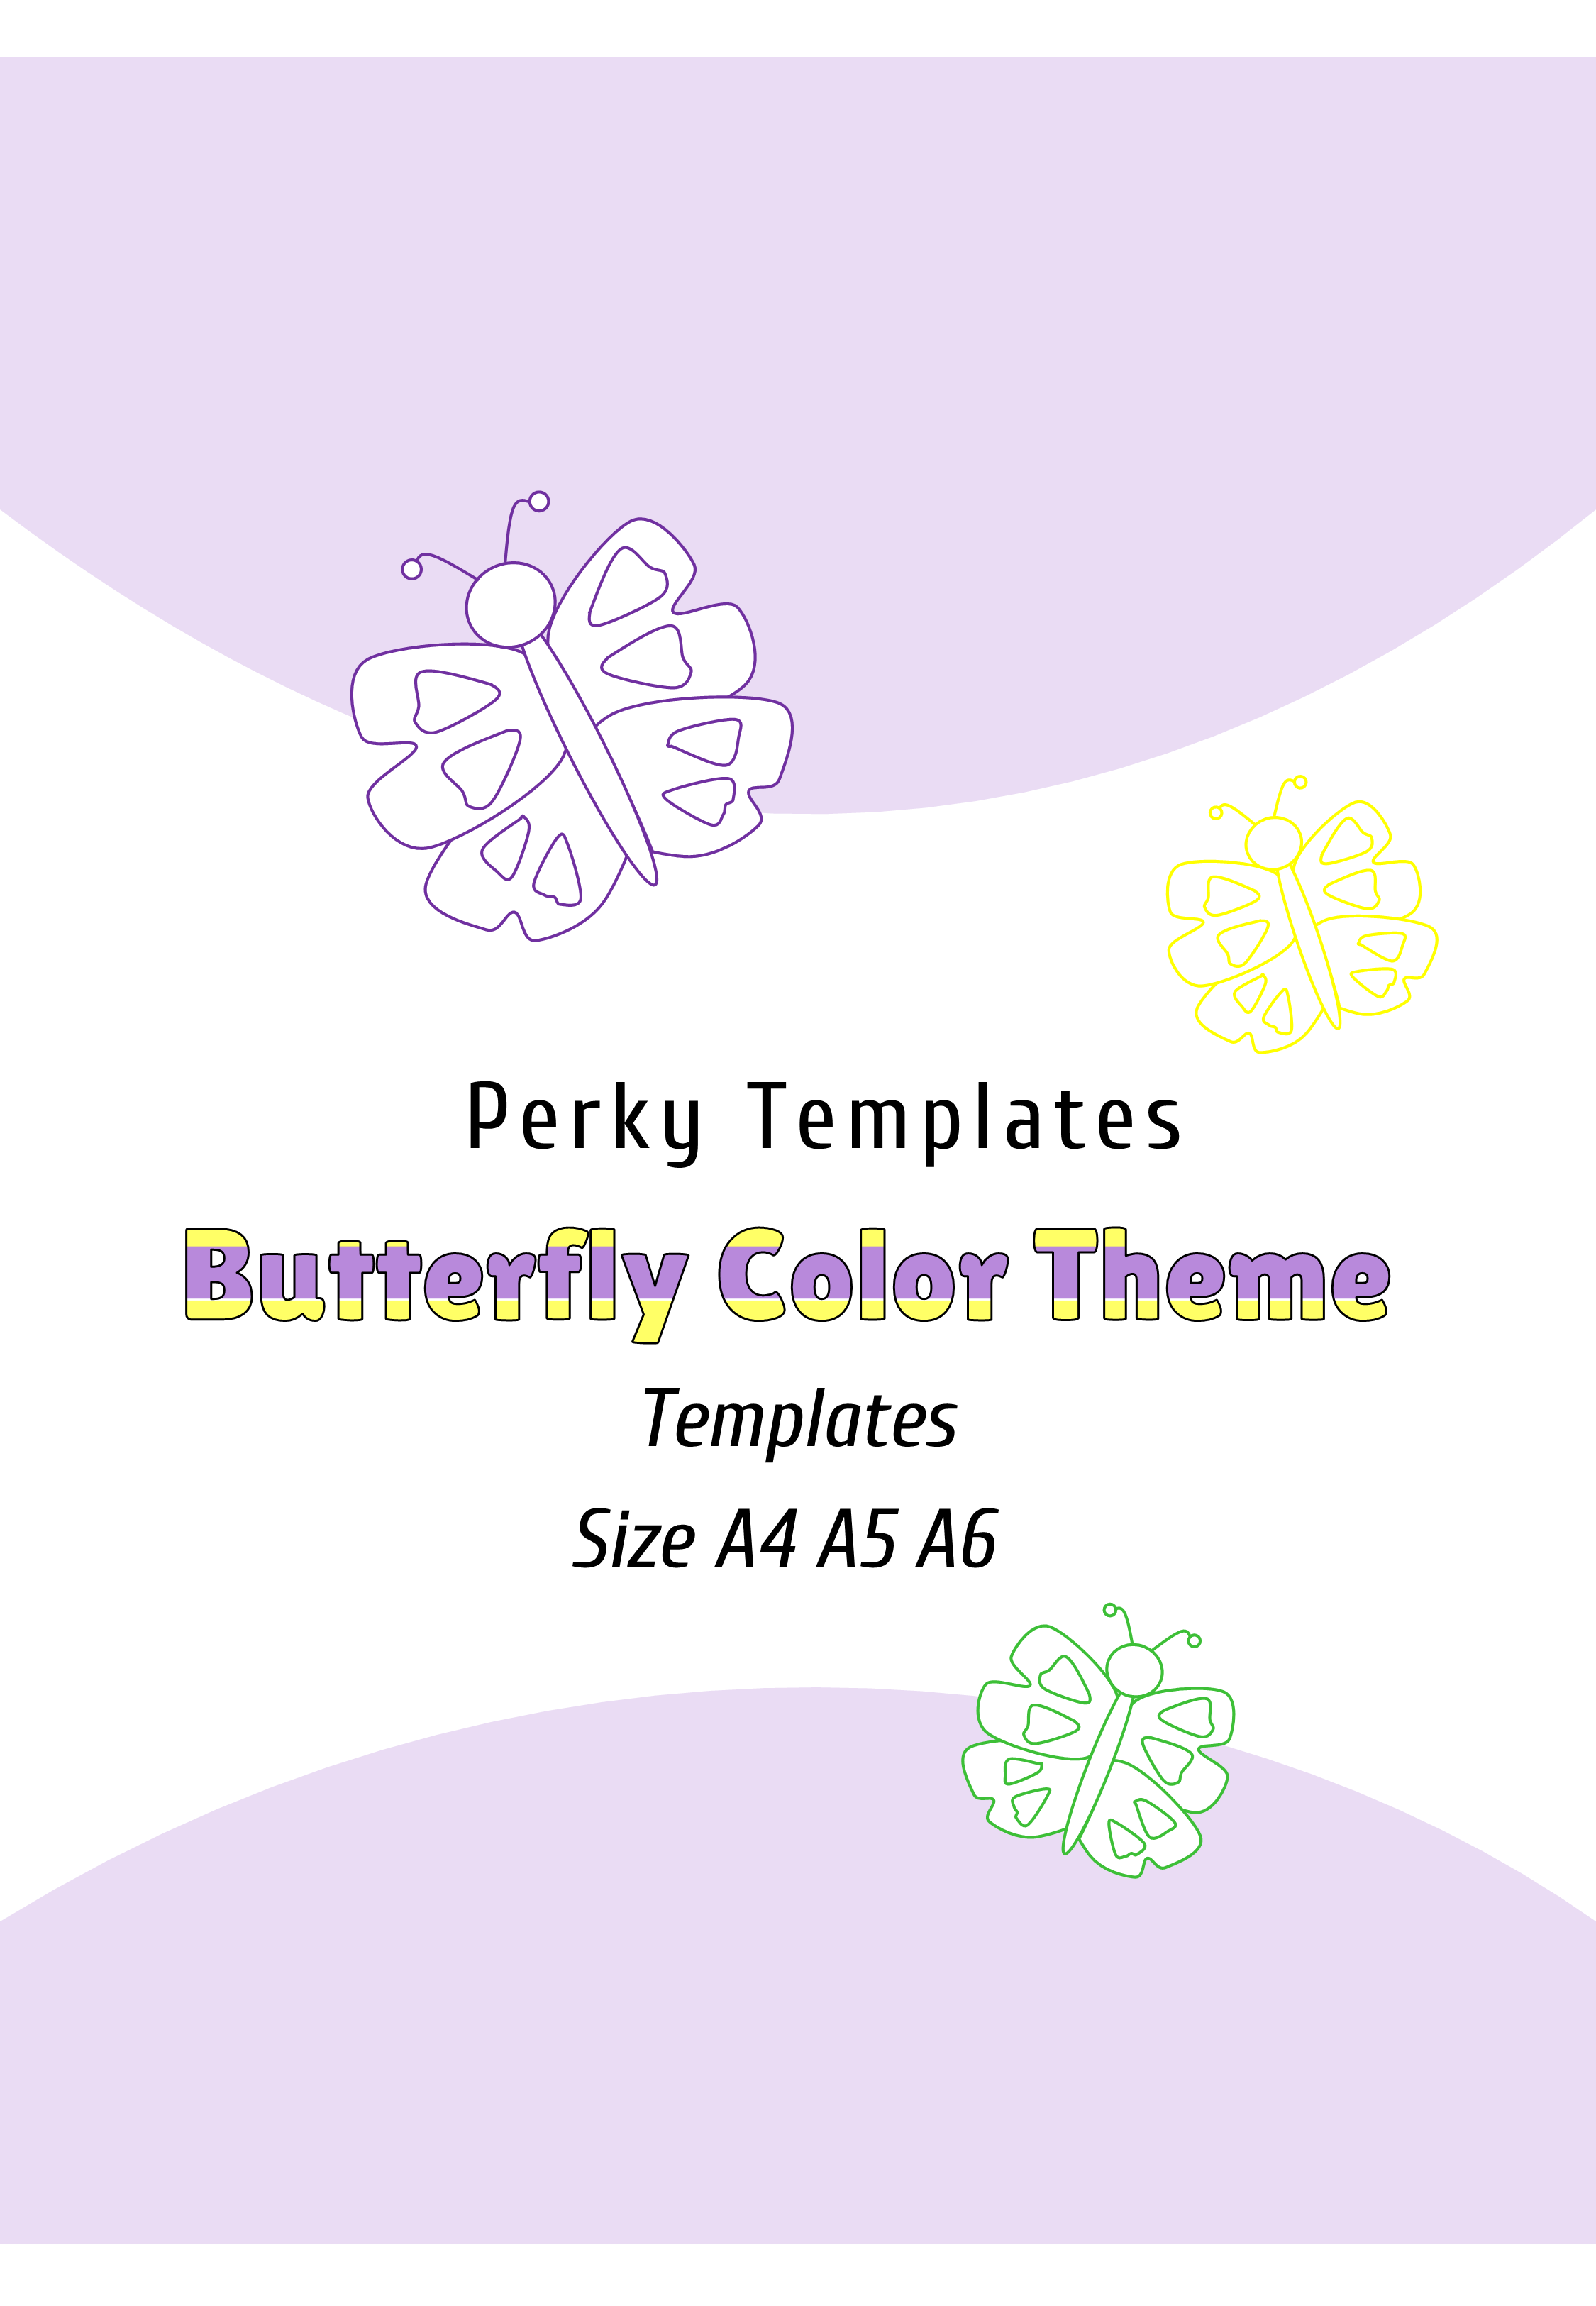

Slide 2
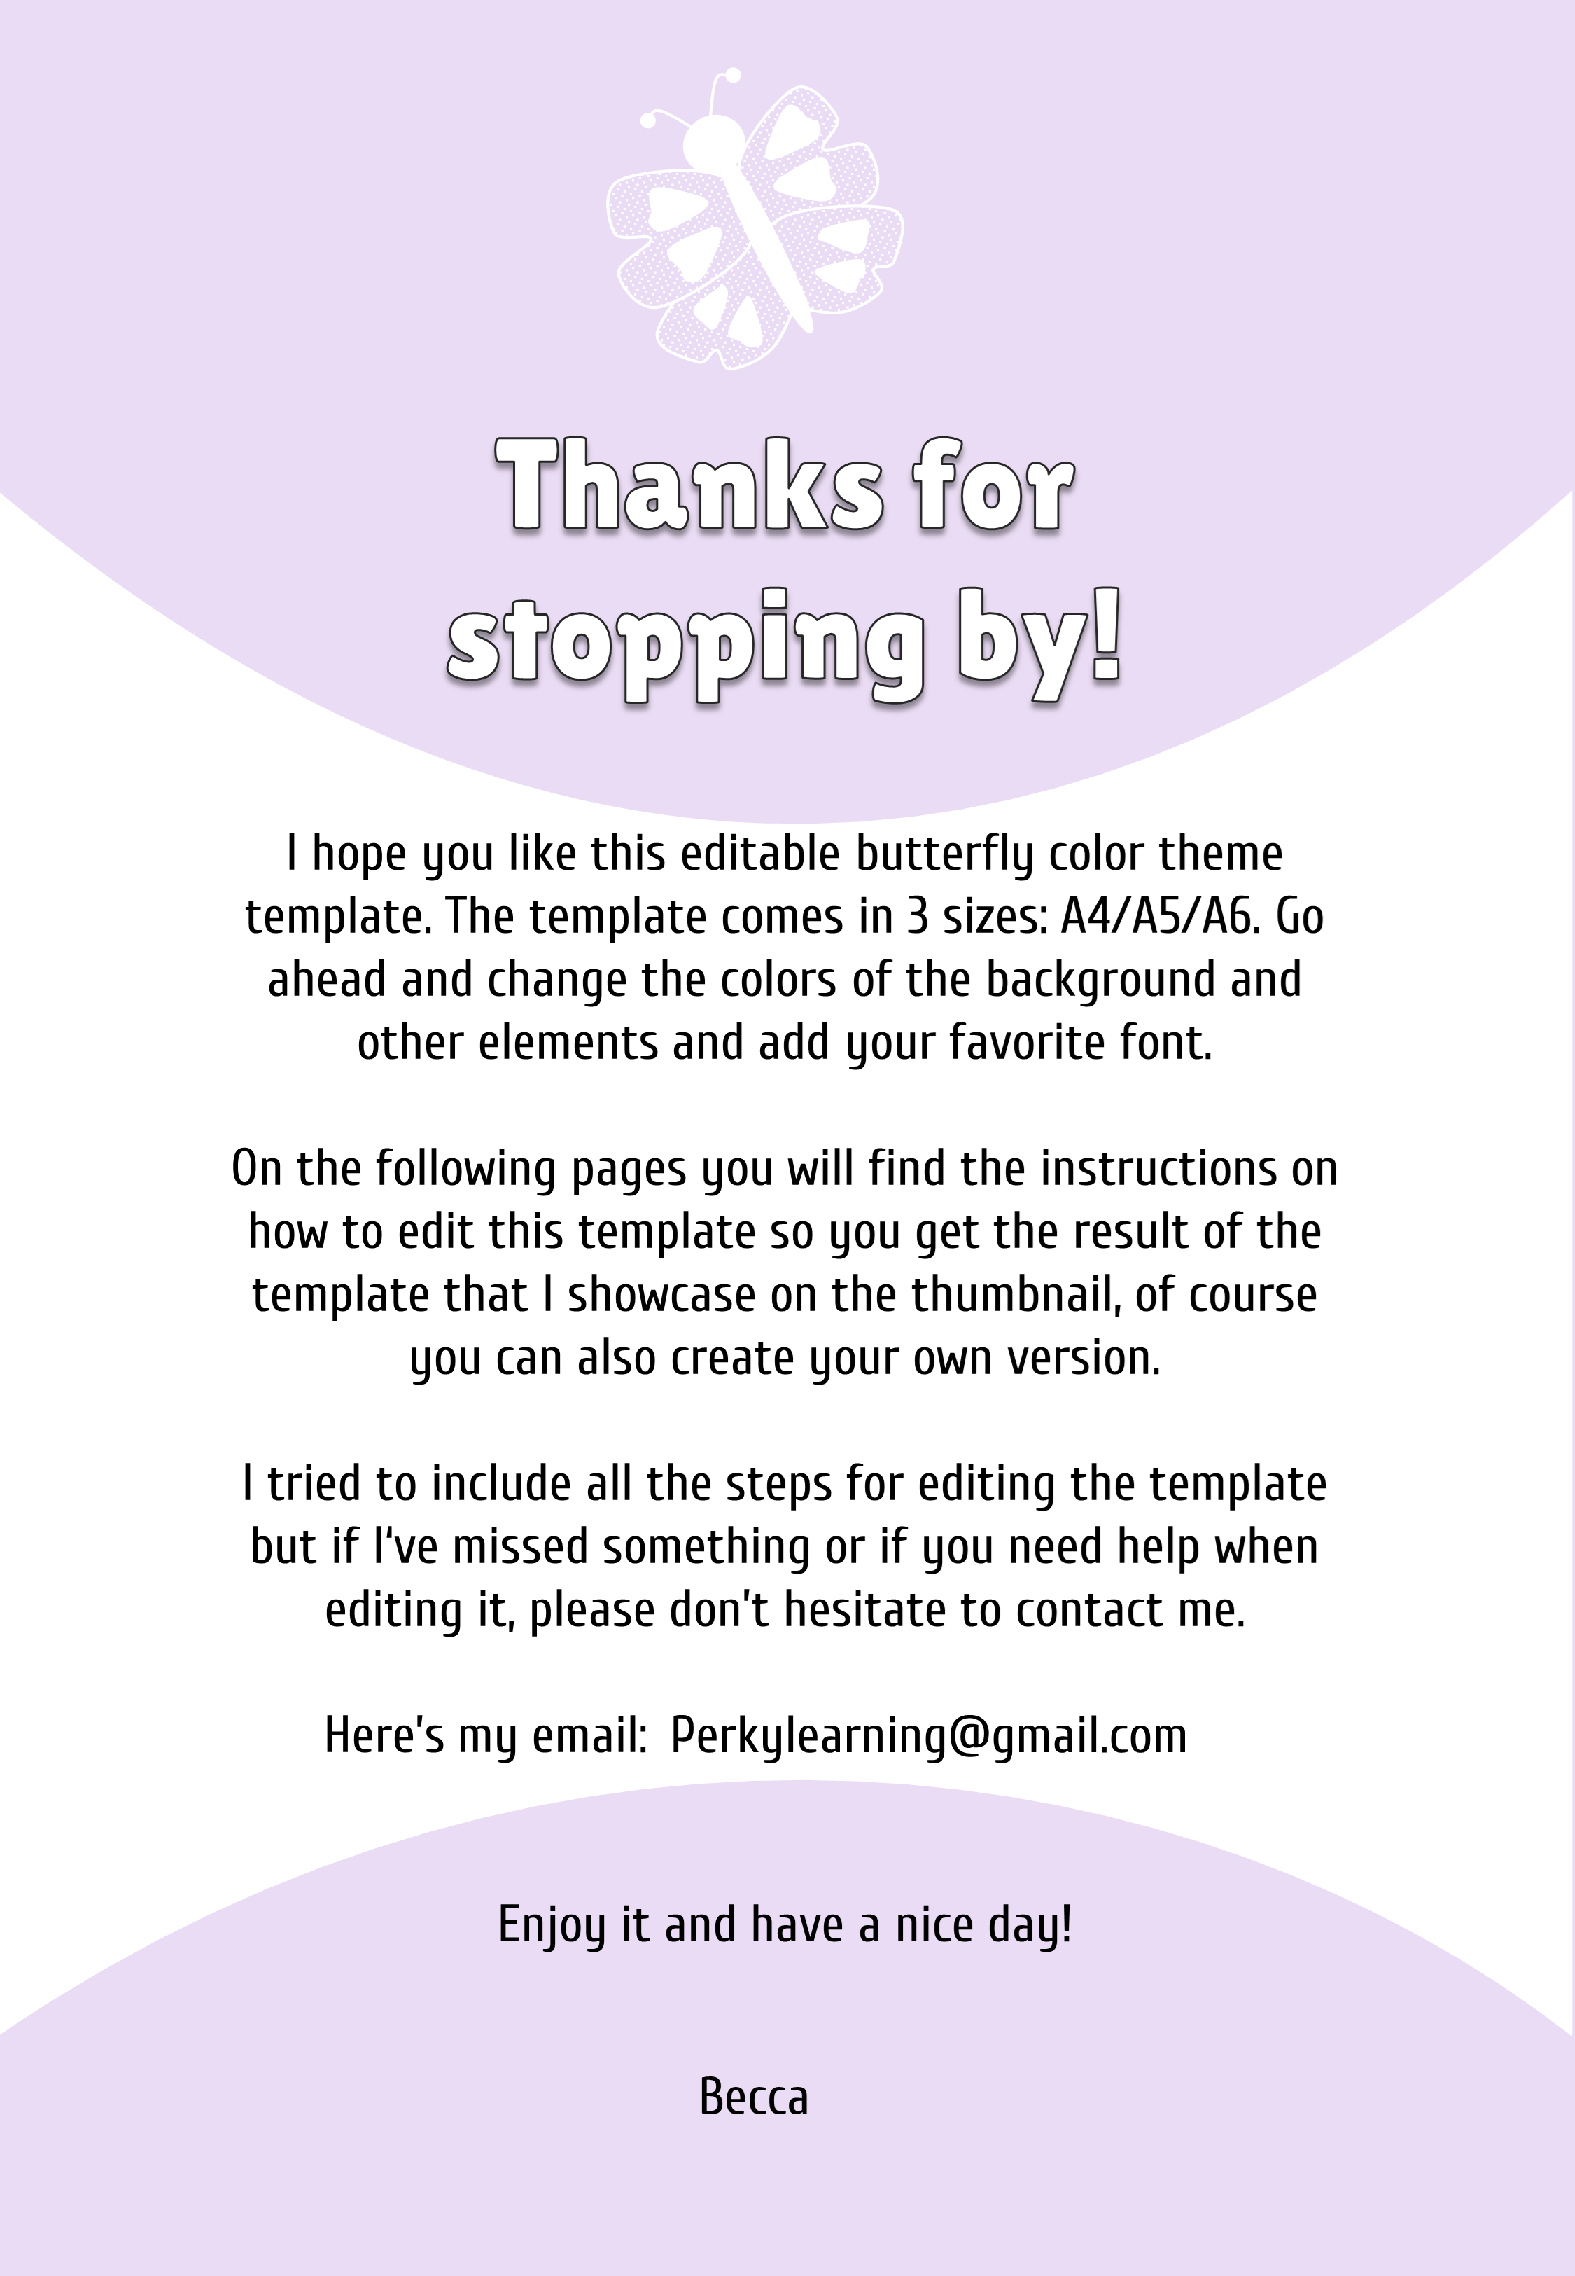

Slide 3
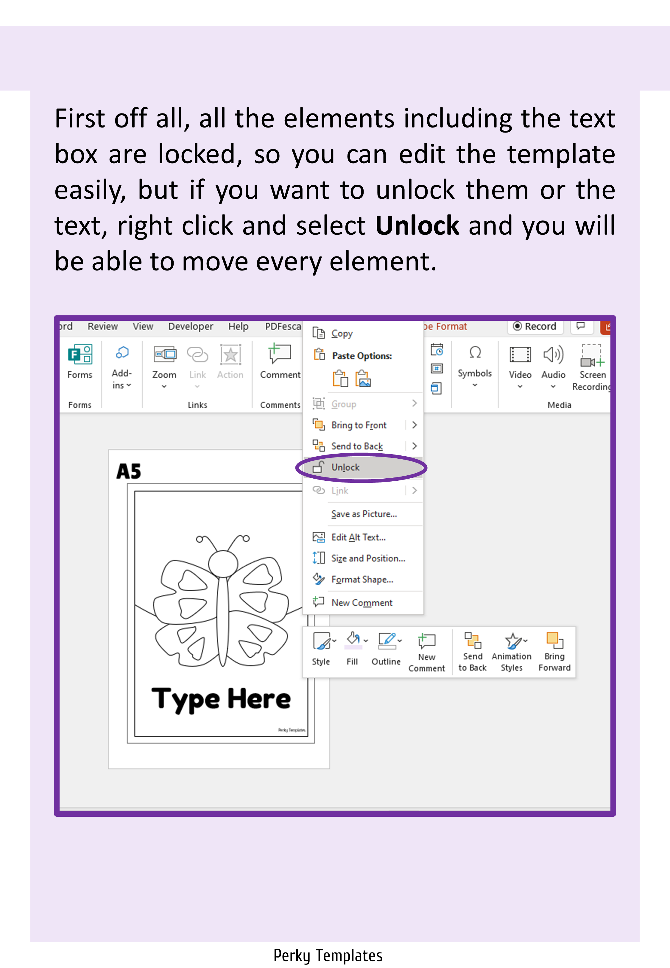

Slide 4
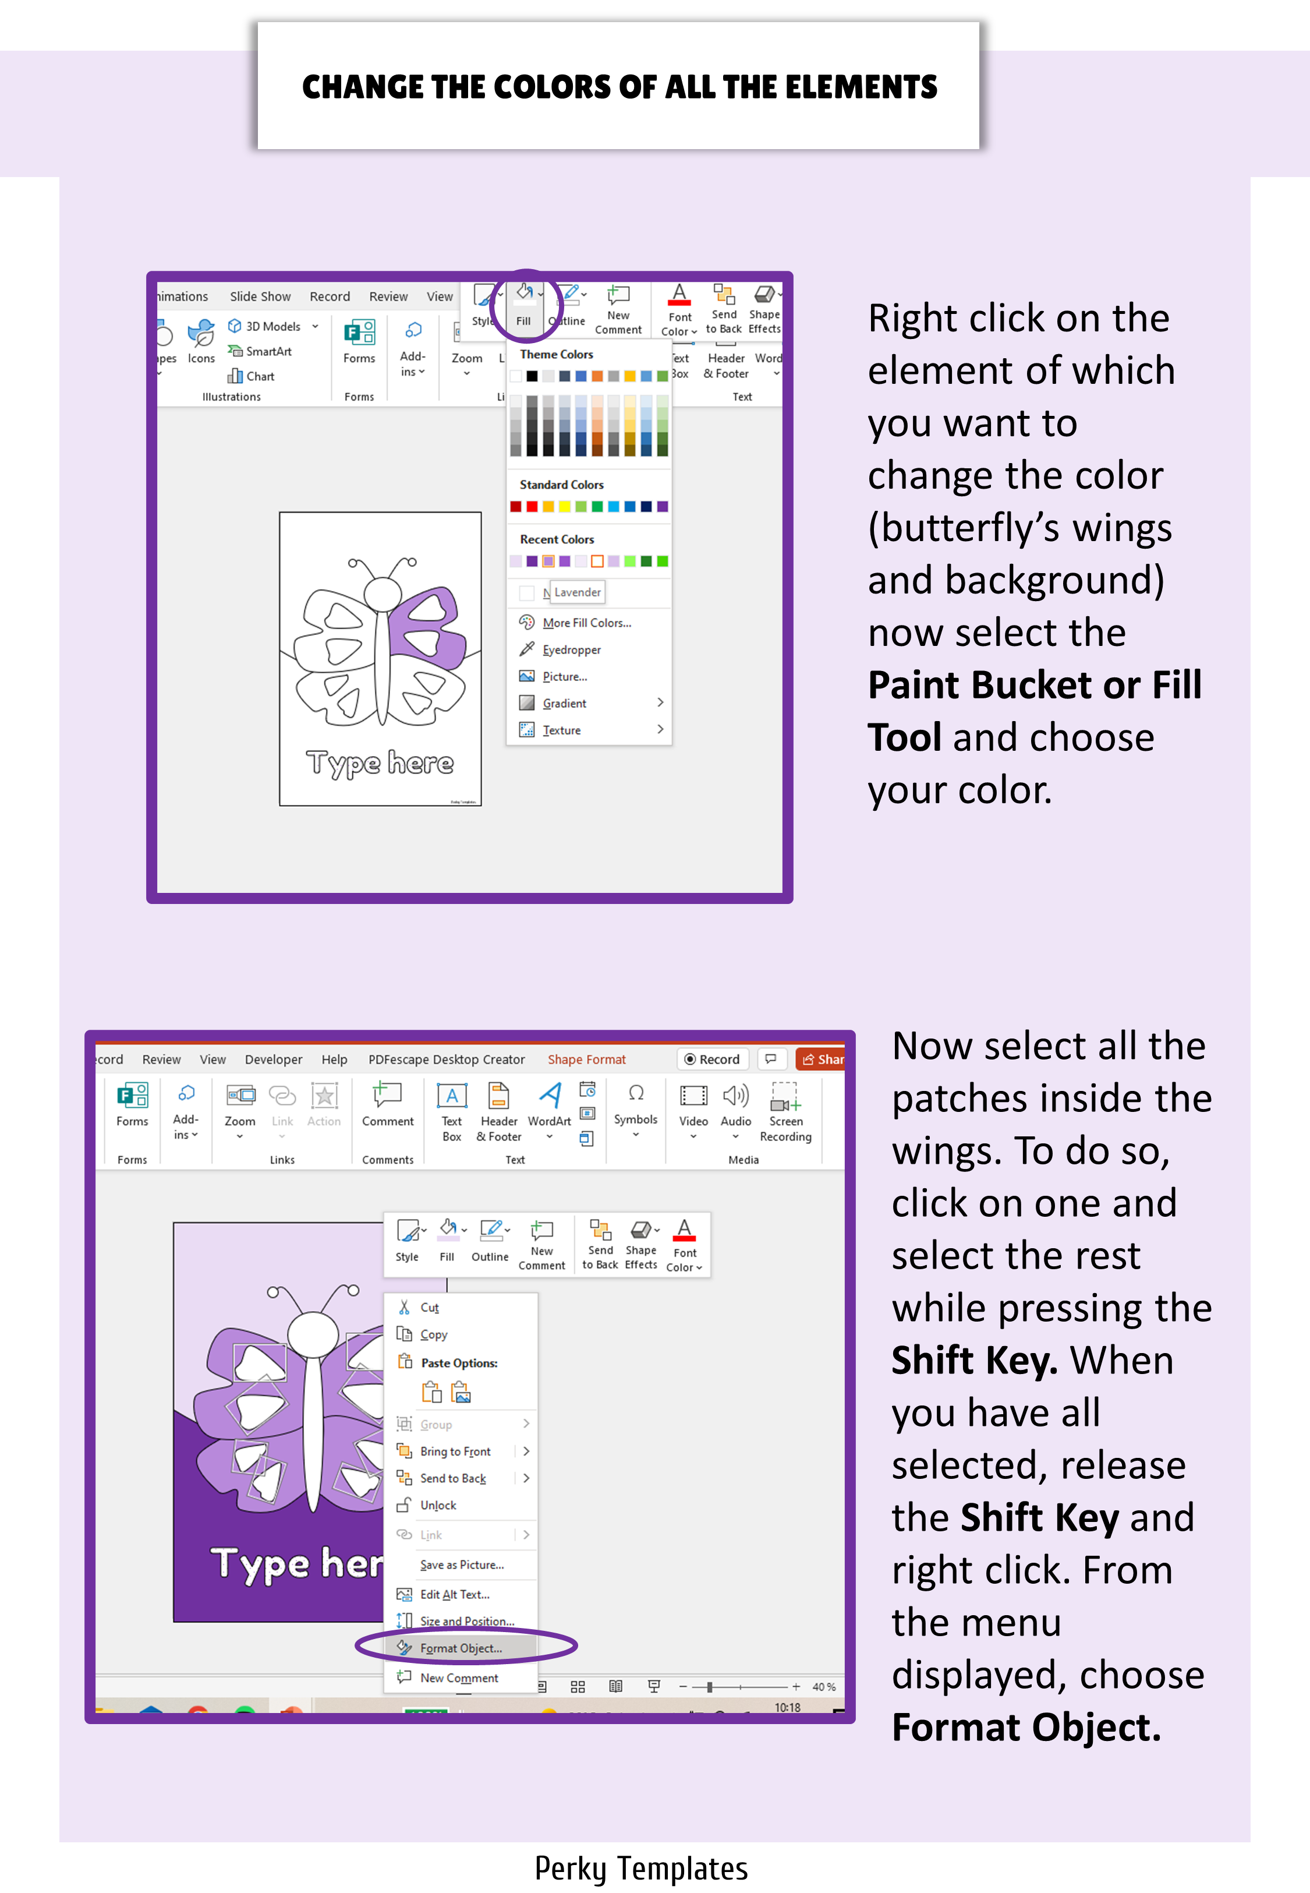

Slide 5
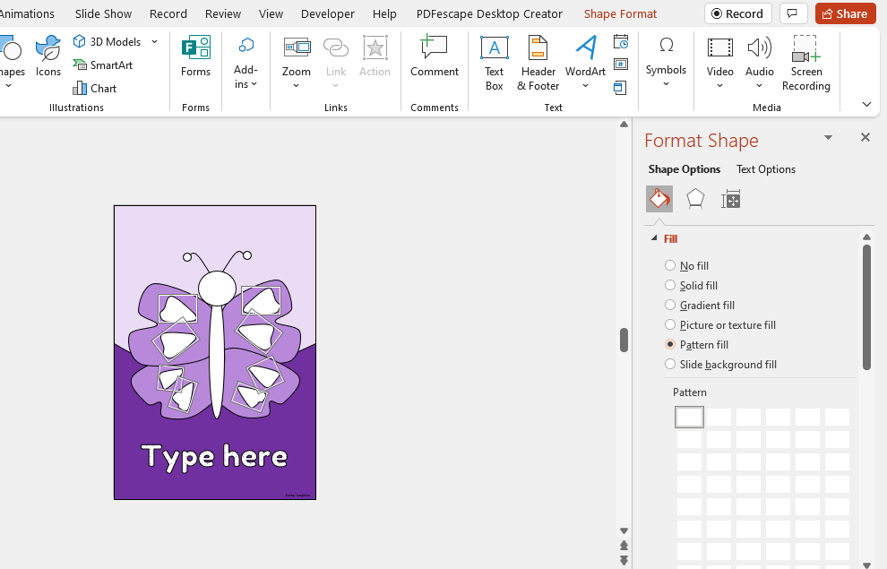
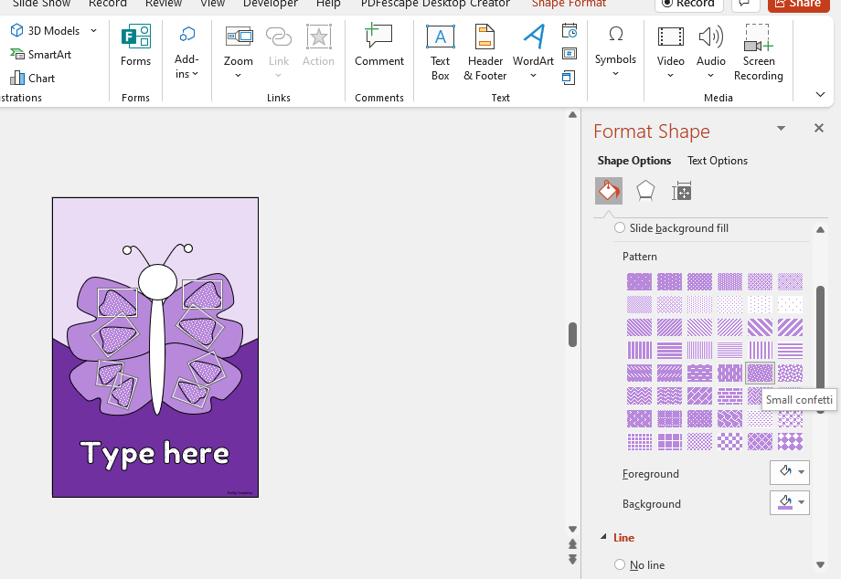
ADD A PATTERN
You will see another menu on the right. There you have to select the Paint Bucket or Fill Tool, then choose Pattern Fill.
There, select the pattern you prefer and your colors. Have fun playing with it! Take the same steps to fill the butterfly’s body and head.
Perky Templates

Slide 6
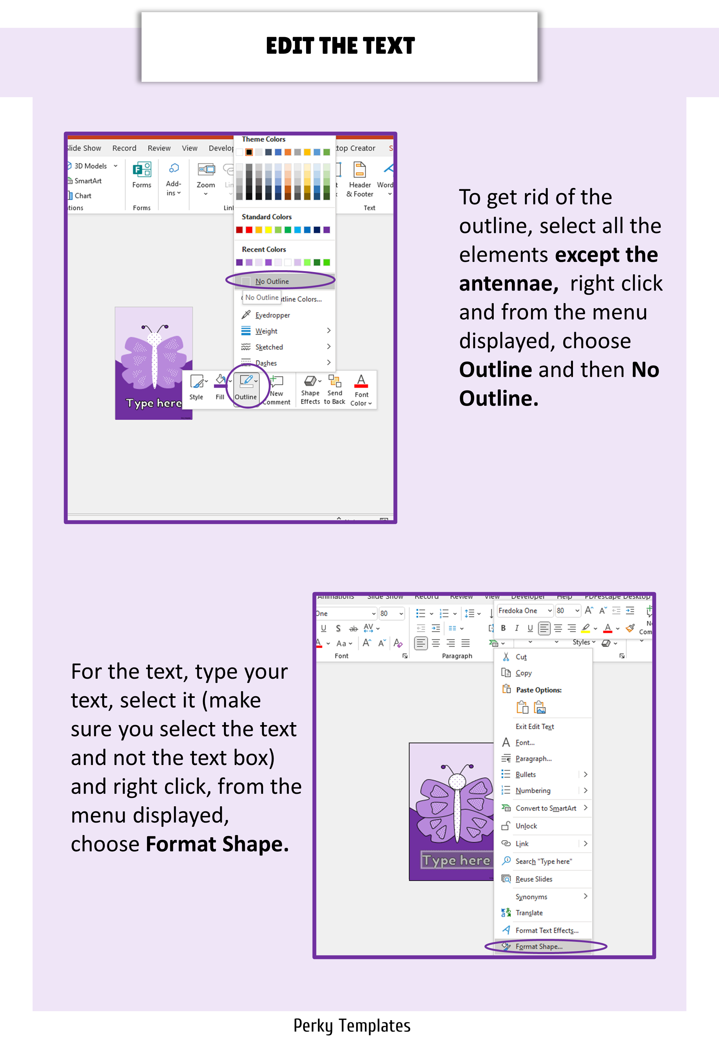

Slide 7
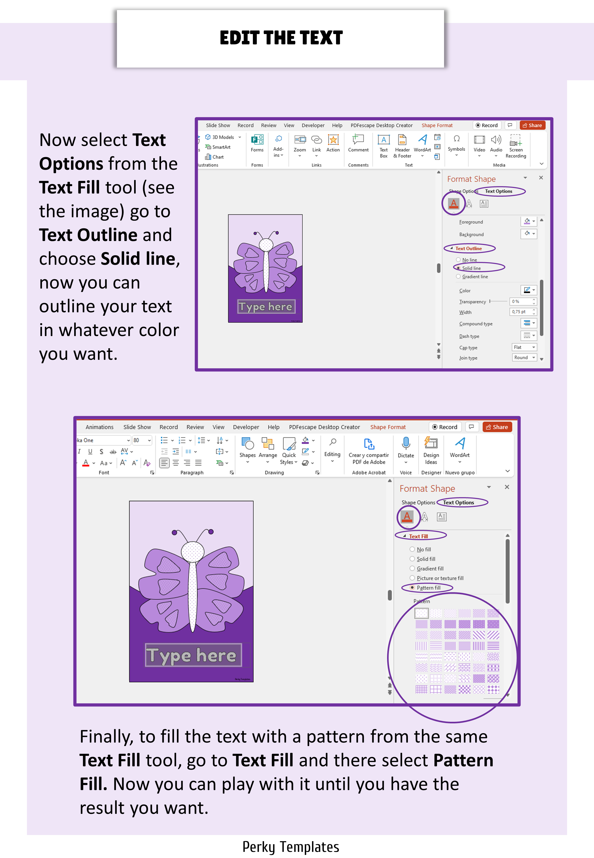
Repeat the process with different colors.

Slide 8
Type here
Perky Templates

Slide 9
A5
AFTER EDITING, PRINT AND CUT OUT!
Type Here
Perky Templates

Slide 10
A6
AFTER EDITING, PRINT AND CUT OUT!
Type Here
Perky Templates

